Slide 2
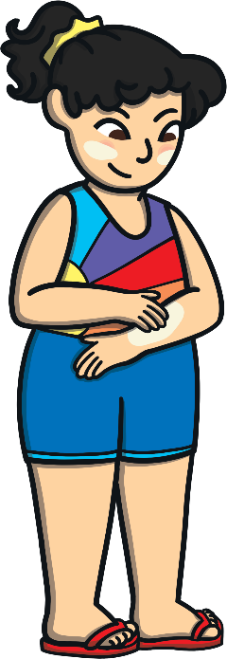
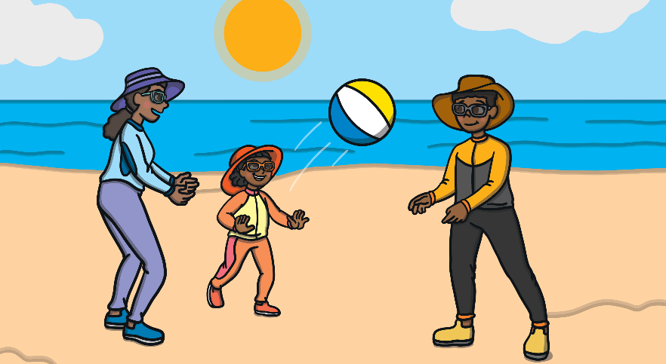
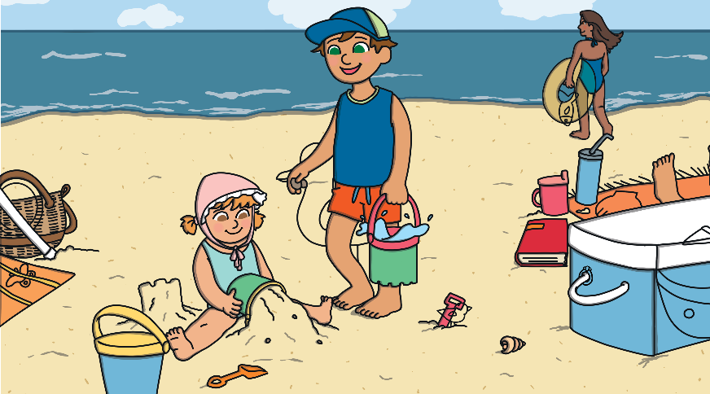
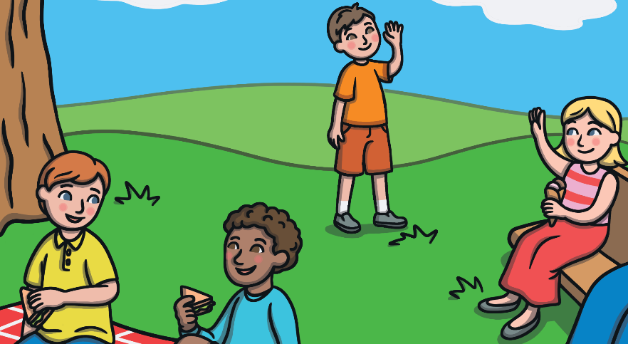
Which Season?
Look at these pictures. Which season do you think it is?
What clues have told you this?

Slide 3
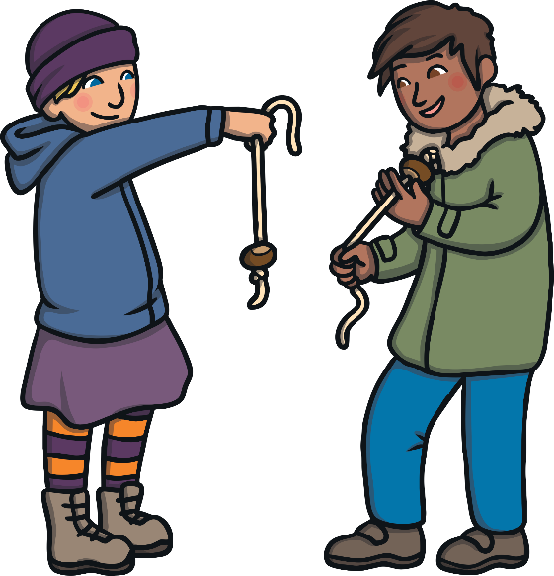
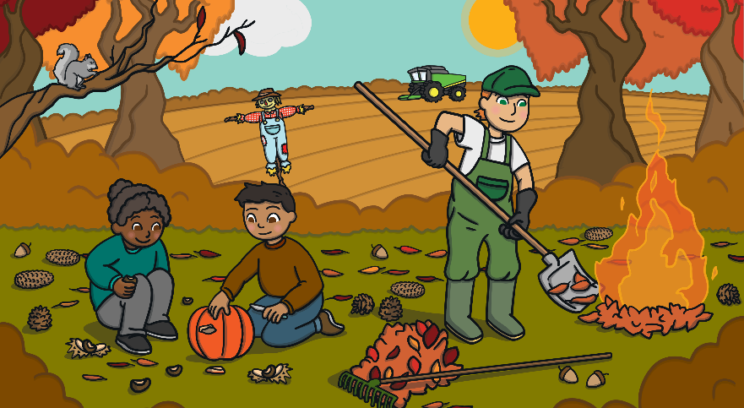
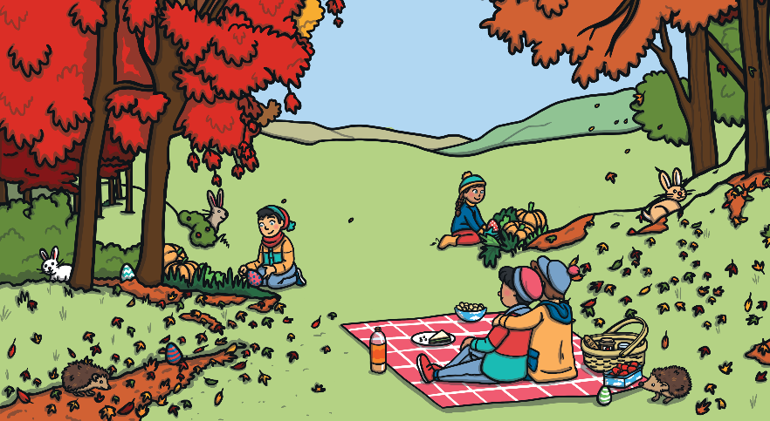
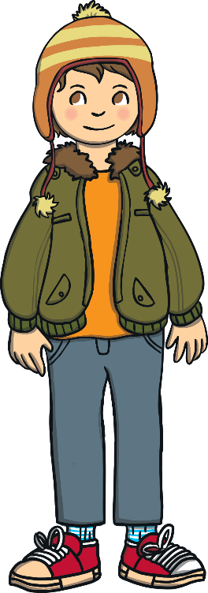
Which Season?
Look at these pictures. Which season do you think it is?
What clues have told you this?

Slide 4
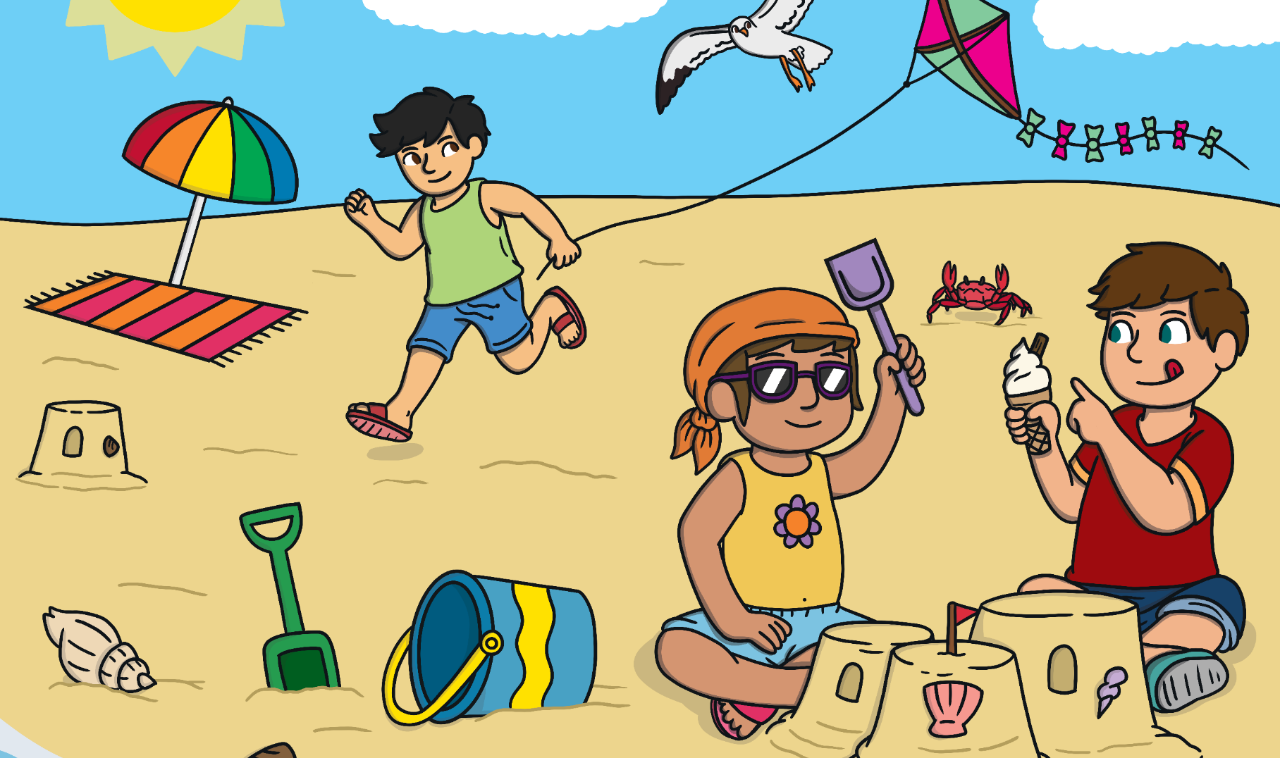
Summer or Autumn?
This picture is of summer. What can you see that tells us this?

Slide 5
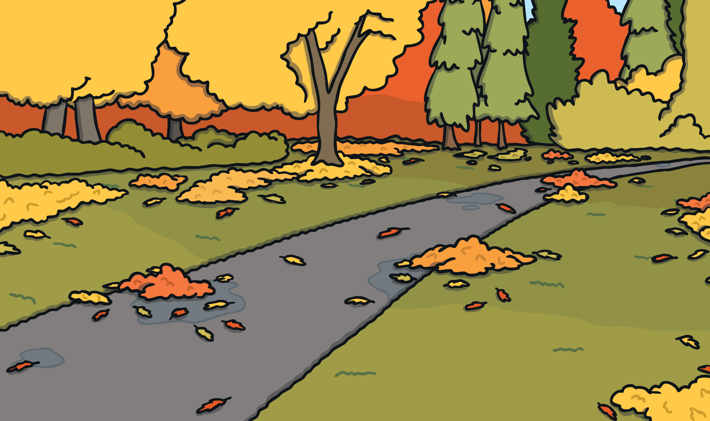
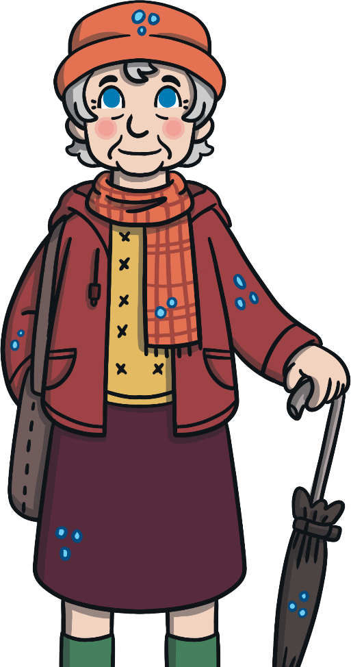
Summer or Autumn?
This picture is of autumn. What can you see that tells us this?

Slide 6
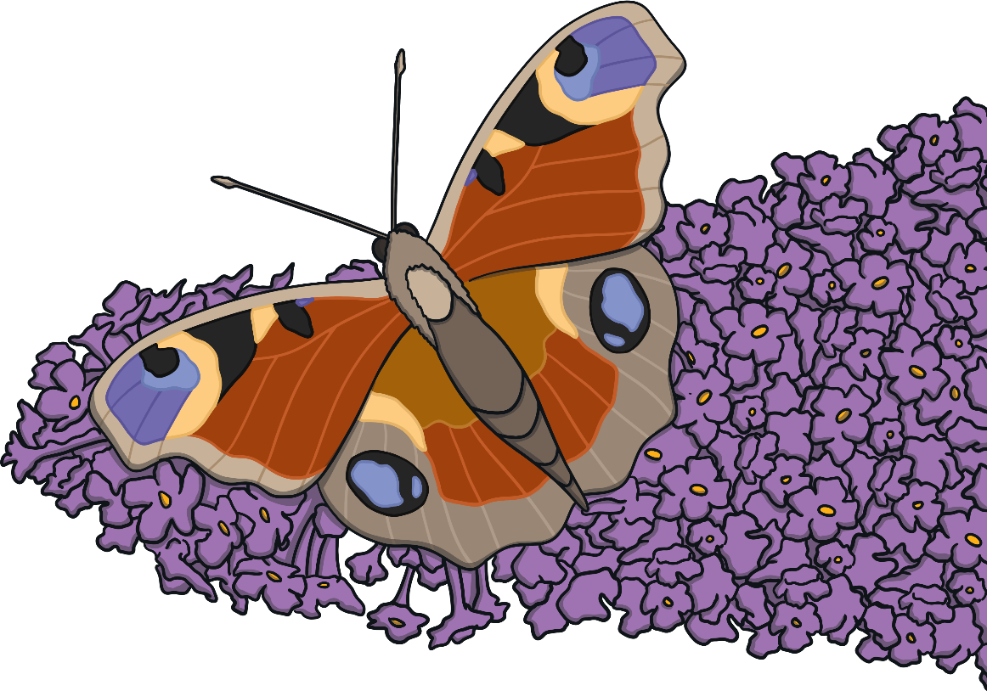
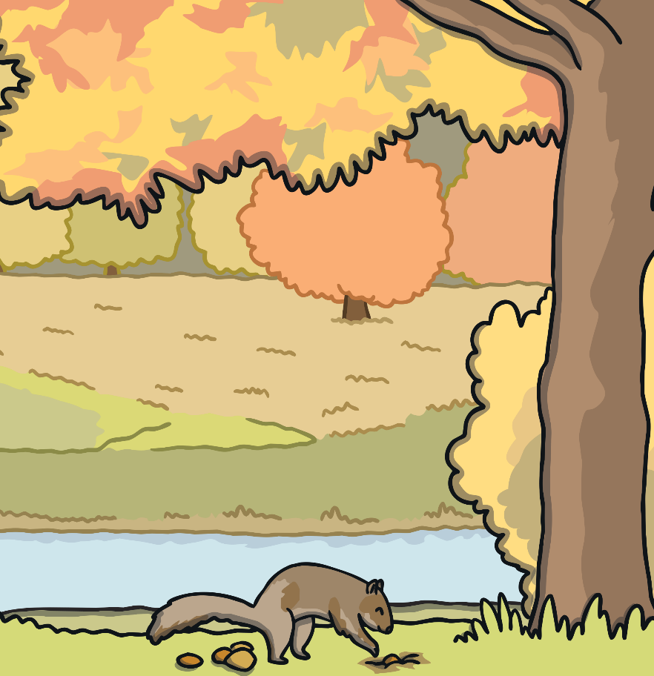
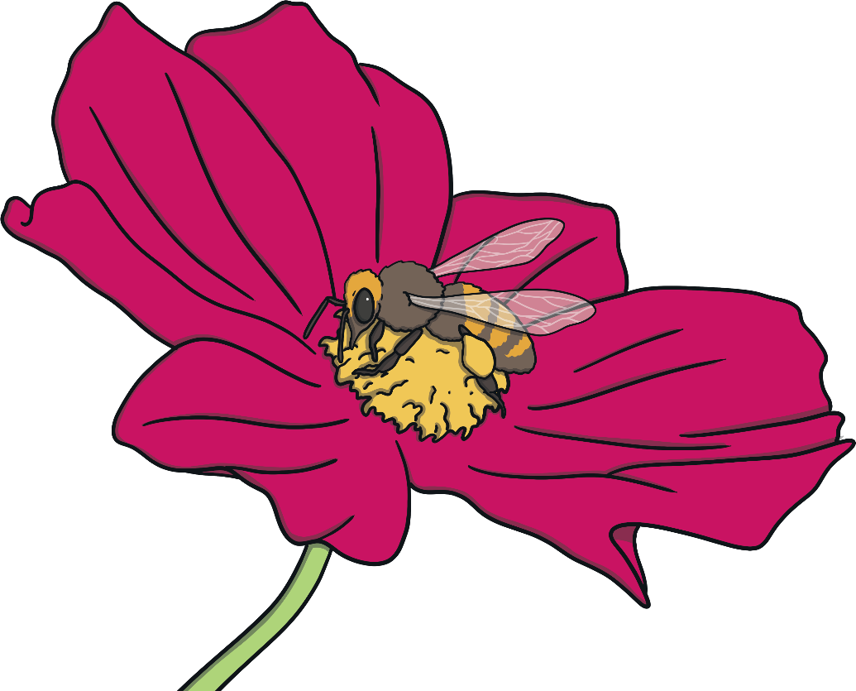
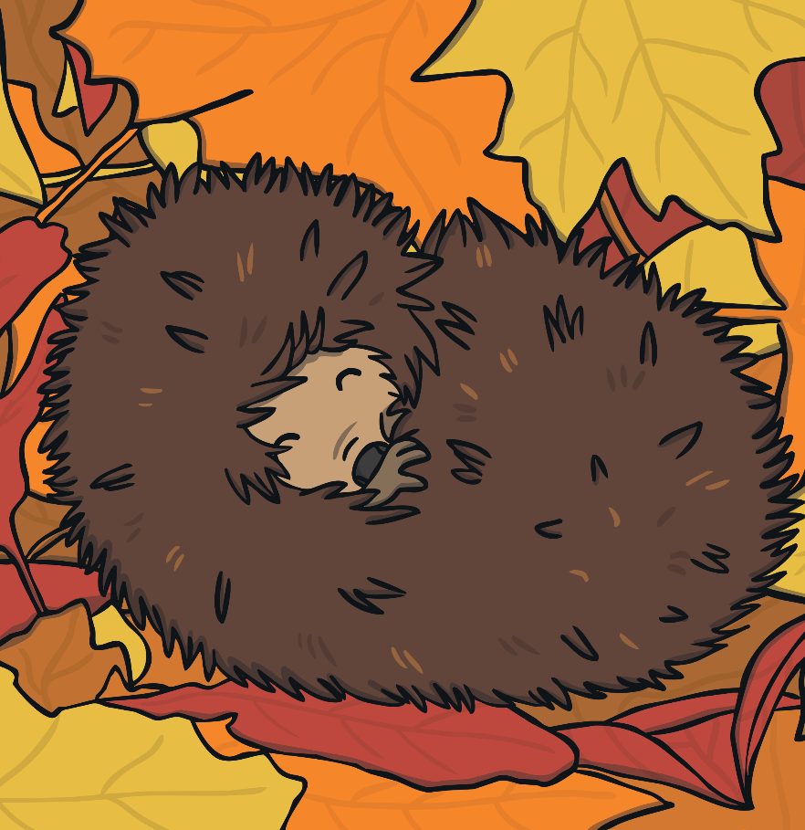
Compare the Seasons
Look at these pictures and compare what animals do in summer with
what they do in autumn.

Slide 7
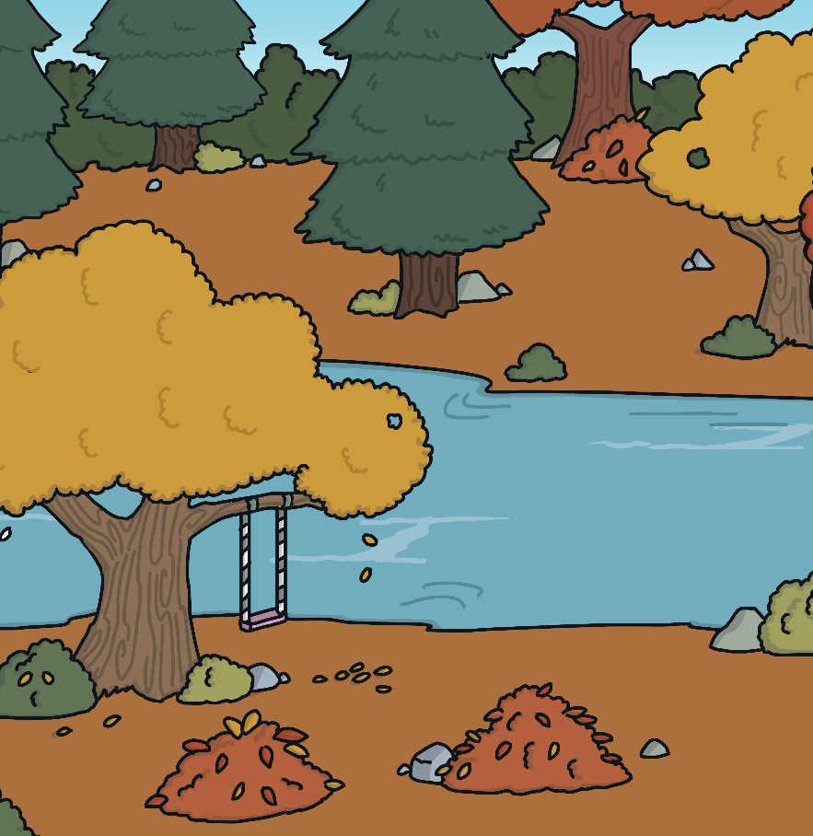
Compare the Seasons
Look at these pictures. Countryside, gardens and parks will look very different in summer compared to autumn. How will they look different?

Slide 8


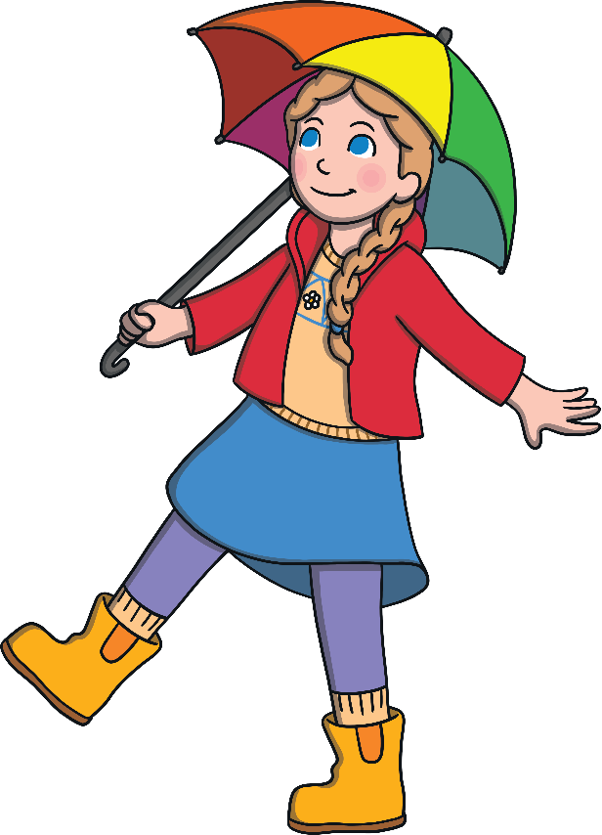
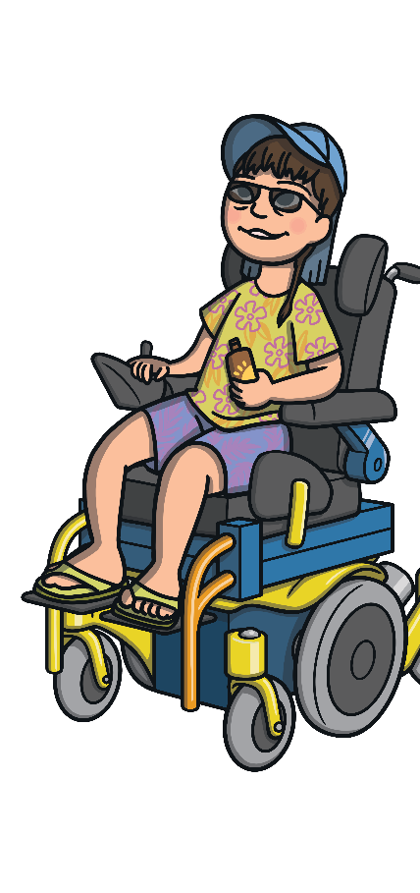
Compare the Seasons
Look at these pictures. Compare clothes that are worn in summer with clothes that are worn in autumn.

Slide 9
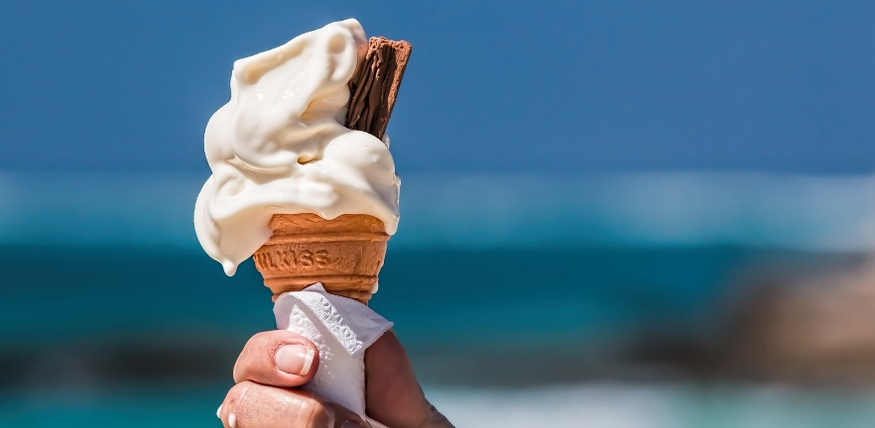
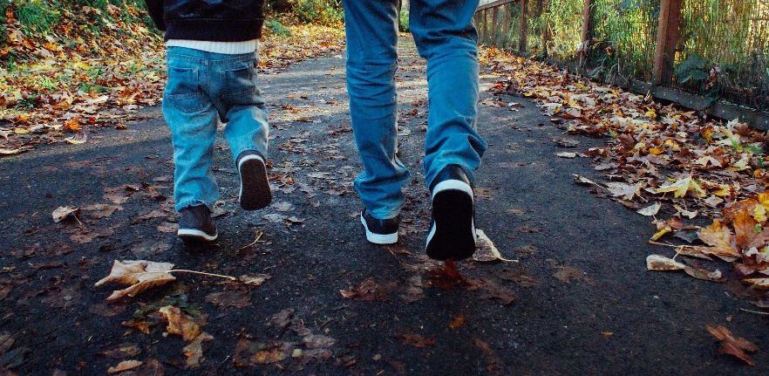
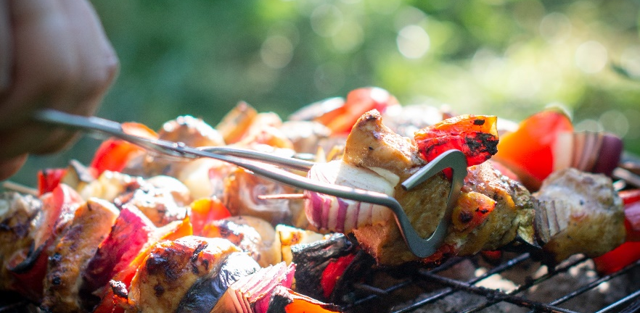
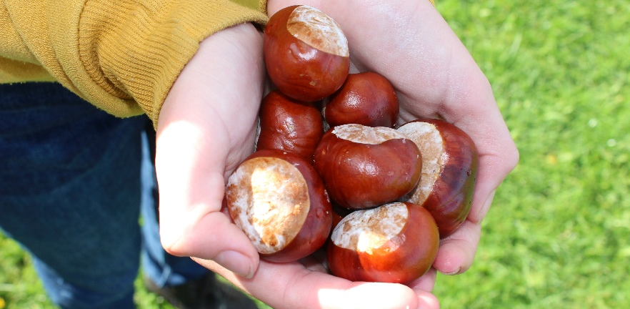
Compare the Seasons
Look at these photos. Compare what people might do in summer with what people might do in autumn.
Why might they do these things during each season?

Slide 10
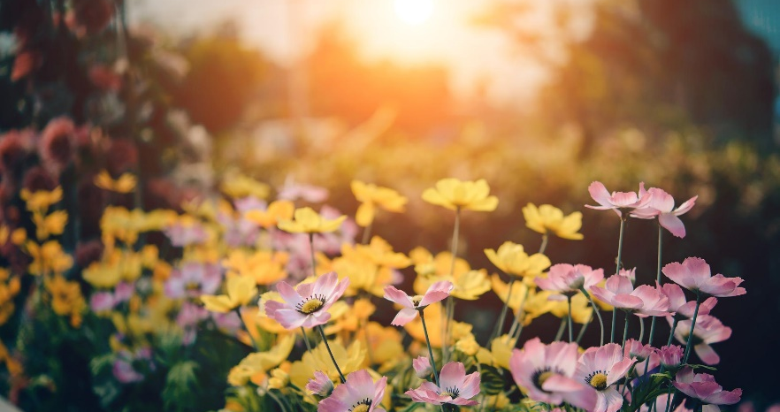
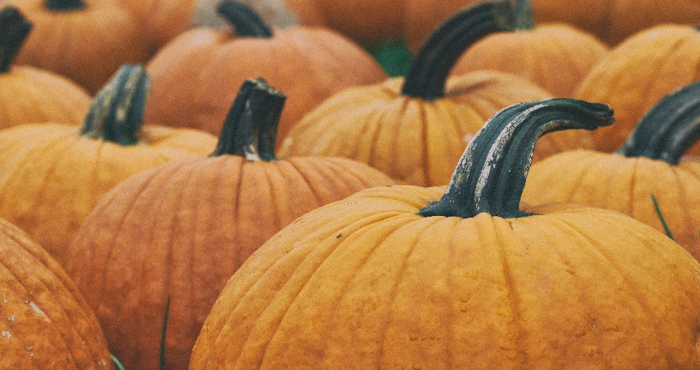
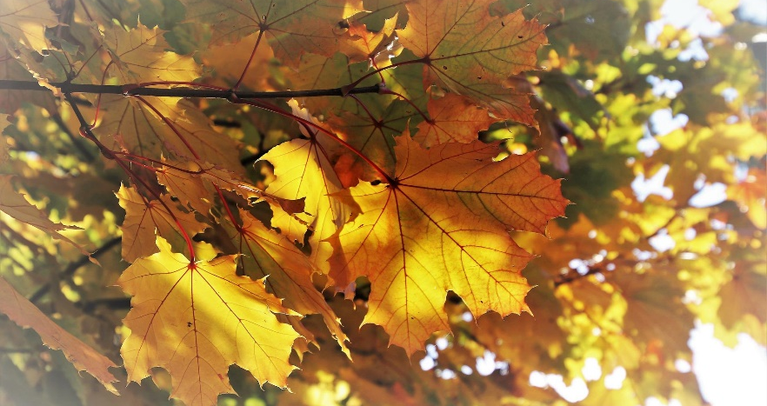
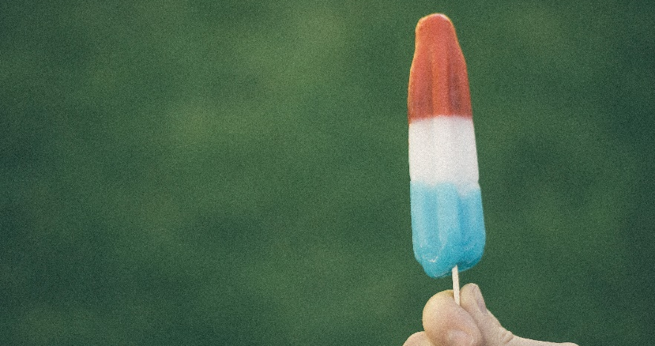
Compare the Seasons
Some of these photos show summer and some show autumn.
Which photos shows which season? Explain how you know.

Slide 11
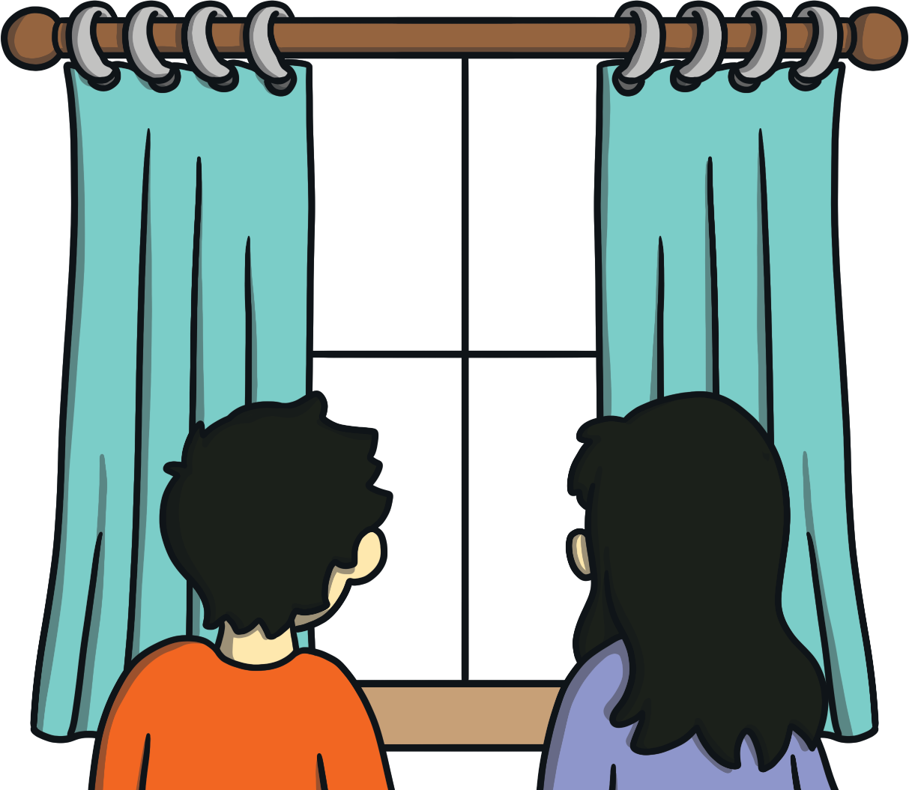
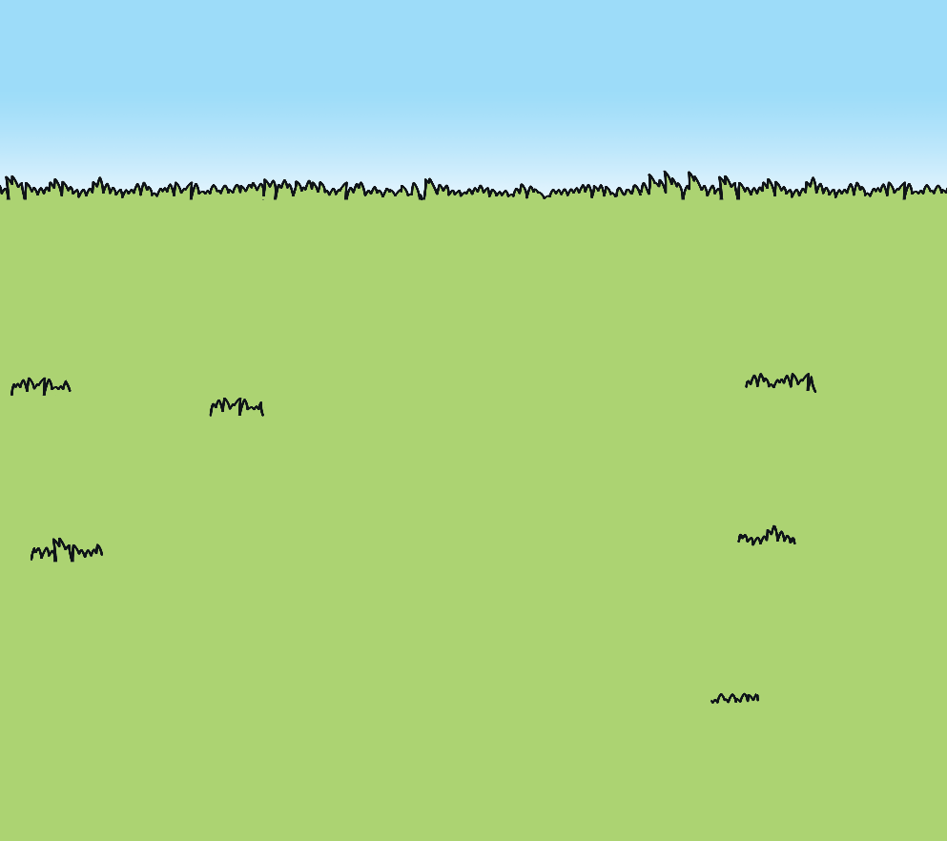
Daylight Hours
Imagine you looked out of your bedroom window at 6 p.m. in summer. What would you see?
What difference would there be if you looked out of the window at the same time in autumn?

Slide 12


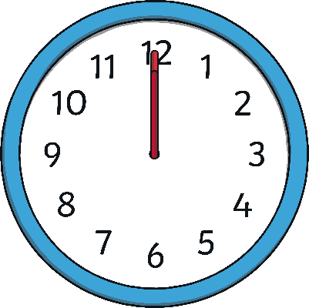
Daylight Hours
Many people who live in the United Kingdom say that the ‘days get longer’ in summer and ‘begin to get shorter’ in autumn. What does this mean?
Summer
Autumn
The days don’t actually get longer or shorter – there are always 24 hours in a day.
But, in summer, there are more hours of daylight and in autumn, there are fewer hours of daylight.
AM
AM
PM
PM

