Slide 2
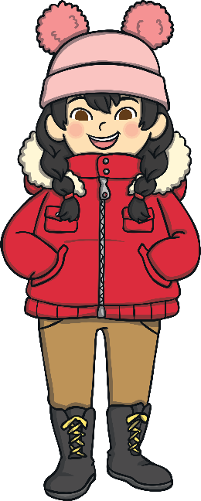
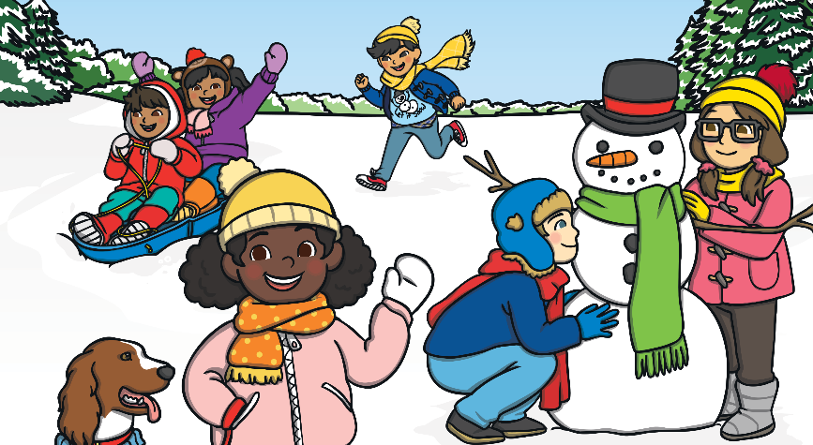
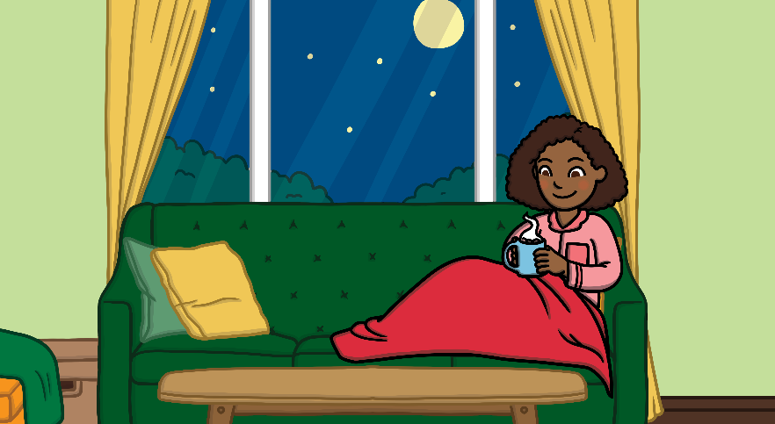
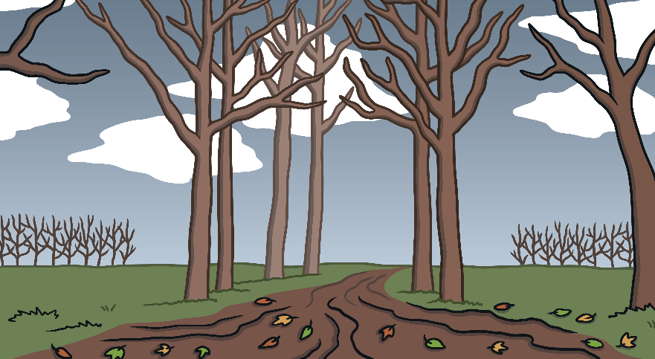

Which Season?
Look at these pictures. Which season do you think it is?
What clues have told you this?

Slide 3
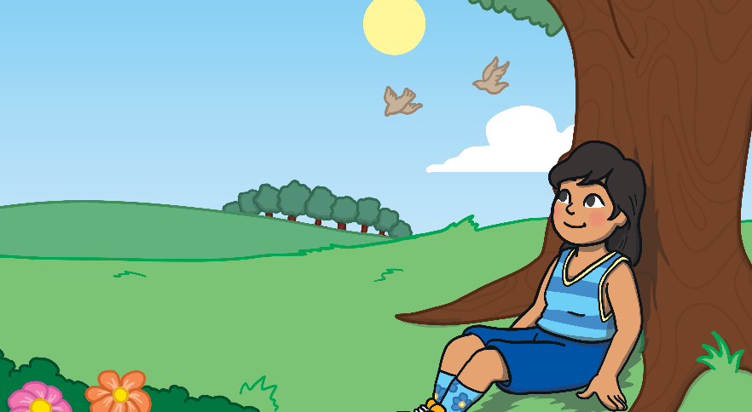
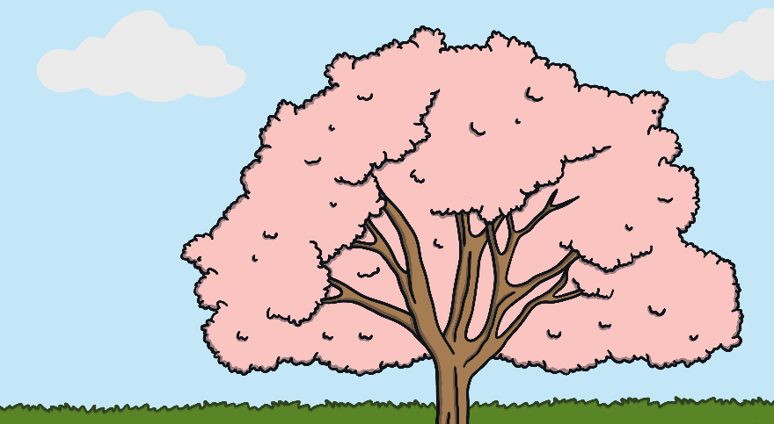
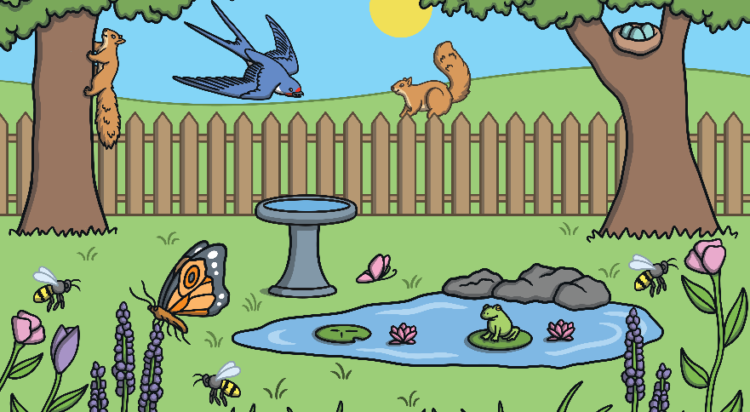
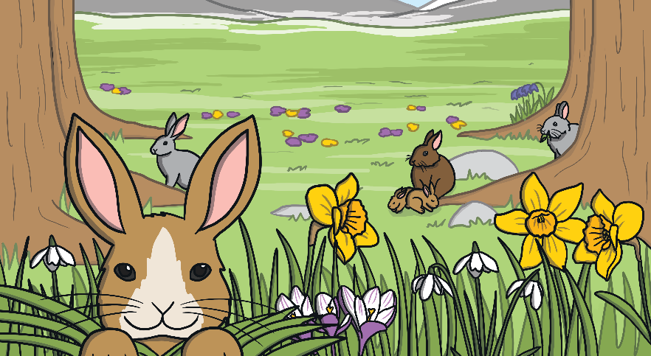
Which Season?
Look at these pictures. Which season do you think it is?
What clues have told you this?

Slide 4
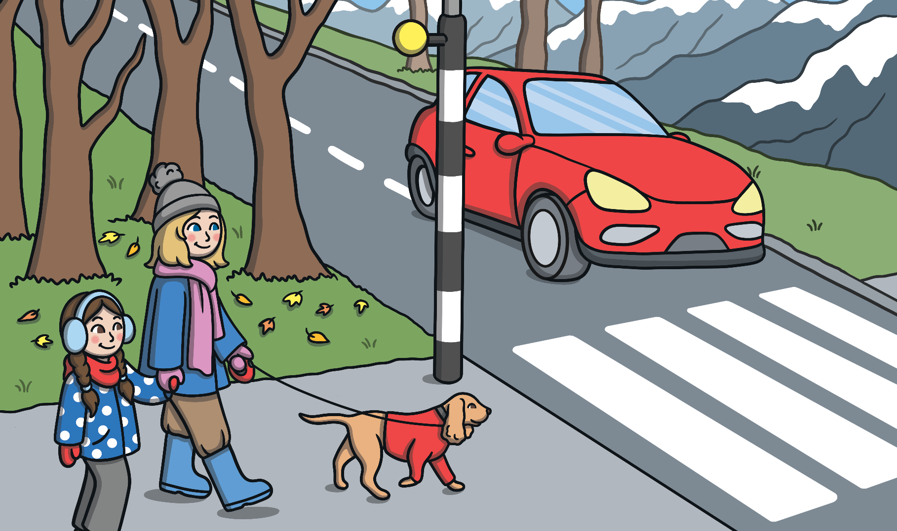
Winter or Spring?
This picture is of winter. What can you see that tells us this?

Slide 5
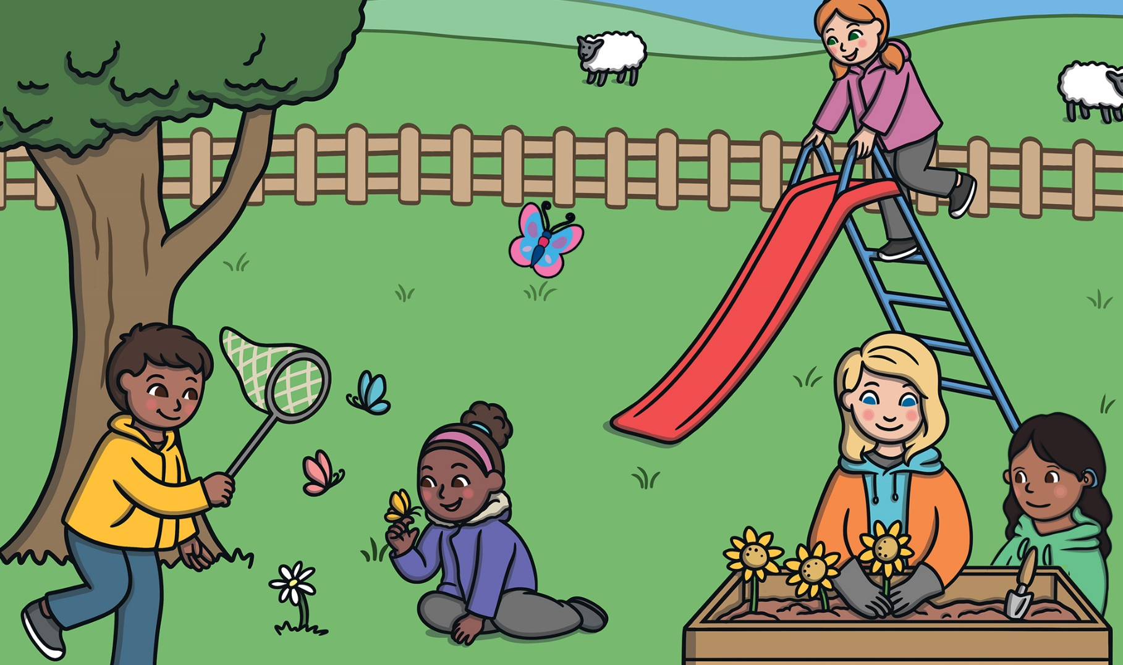
Winter or Spring?
This picture is of spring. What can you see that tells us this?

Slide 6
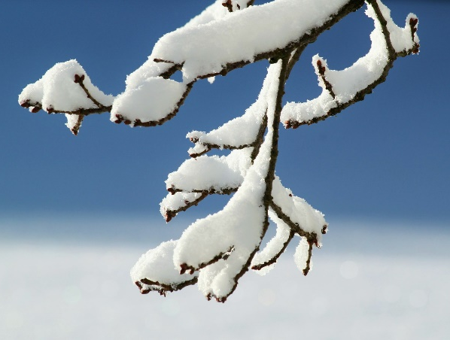
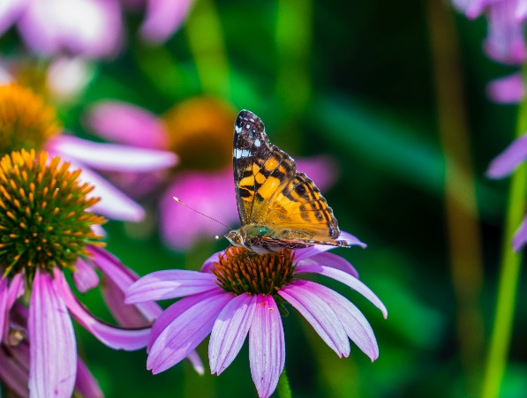
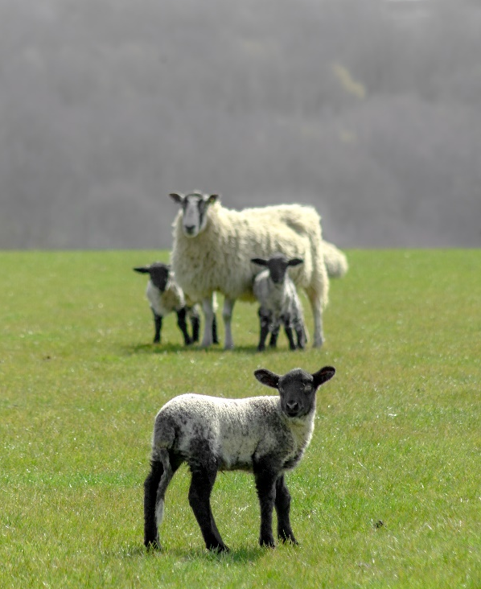
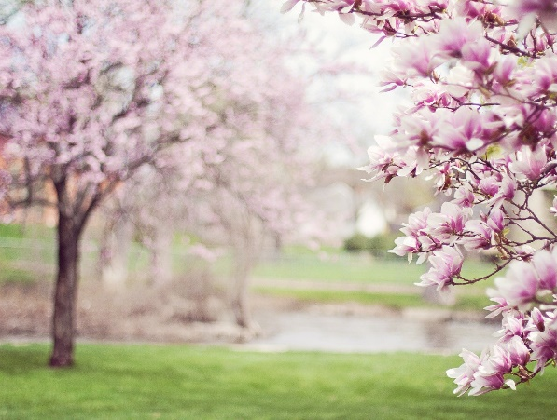
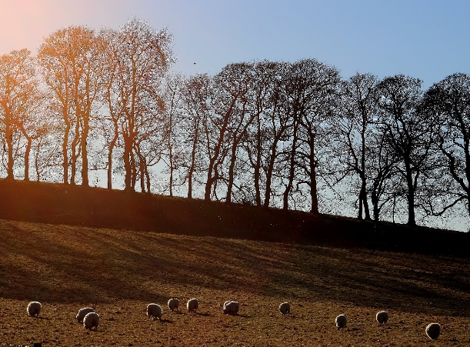
Winter or Spring?
Some of these photos show winter and some show spring.
Which photos show which season? Explain how you know.
winter
spring
spring
spring
winter

Slide 7
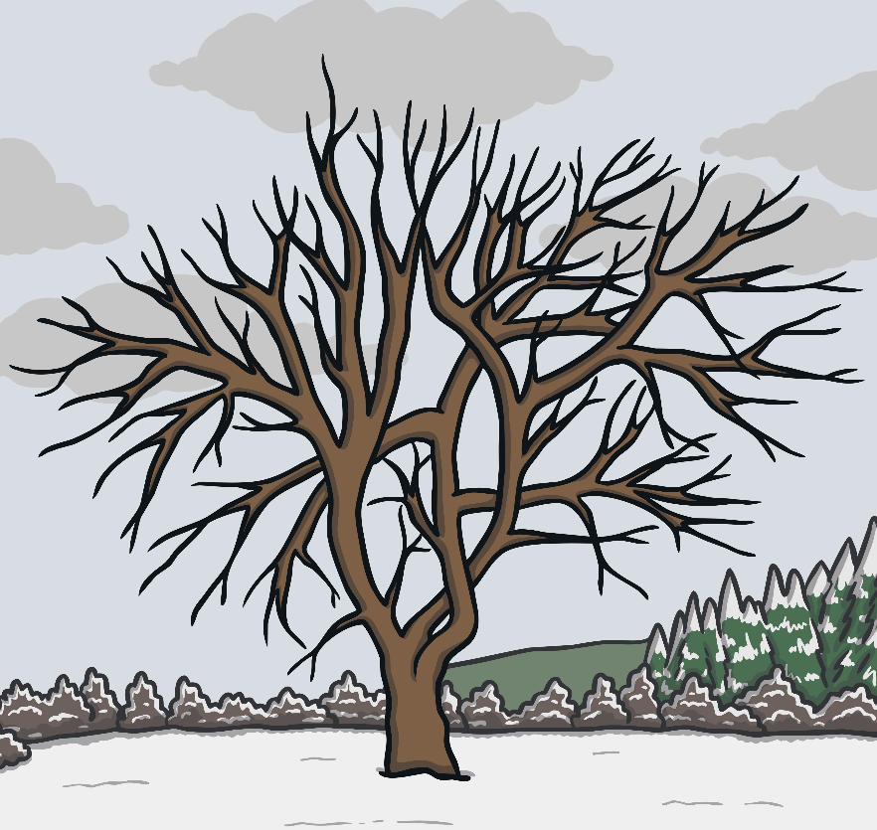
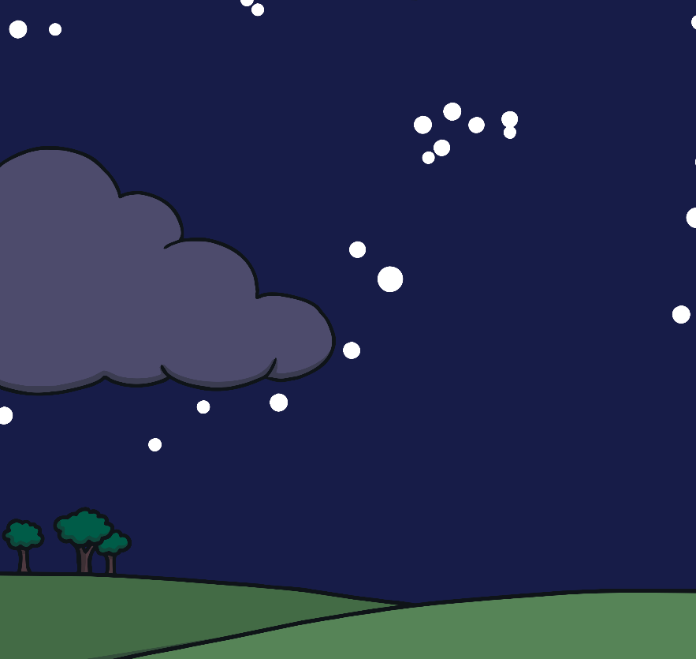
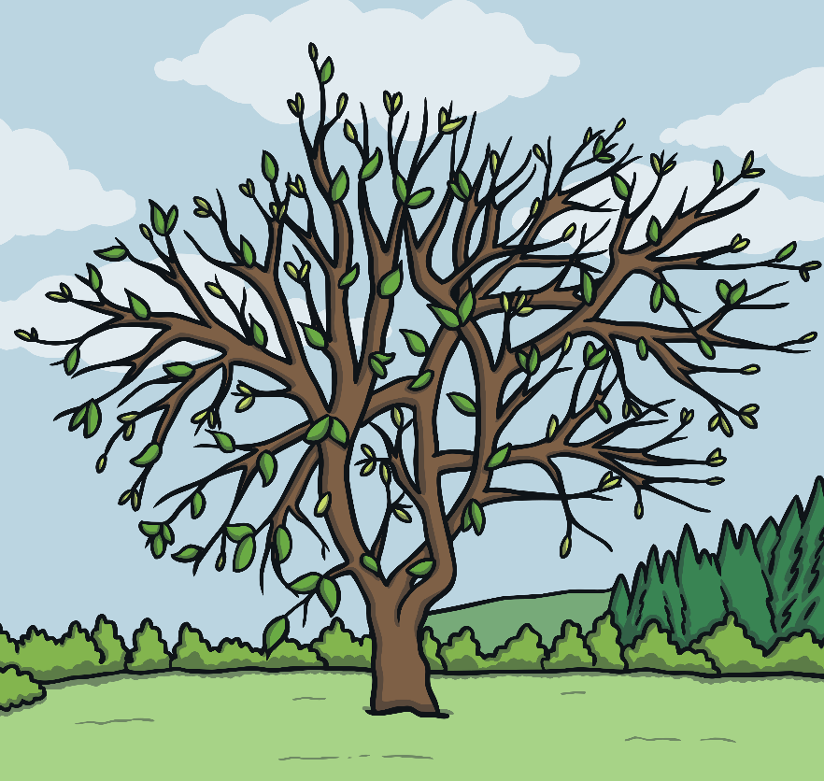
Compare the Seasons
Look at these pictures.
Compare what is happening in winter with what is happening in spring.
What is different?
0
4
:
3
0
P
M
0
4
:
3
0
P
M

Slide 8
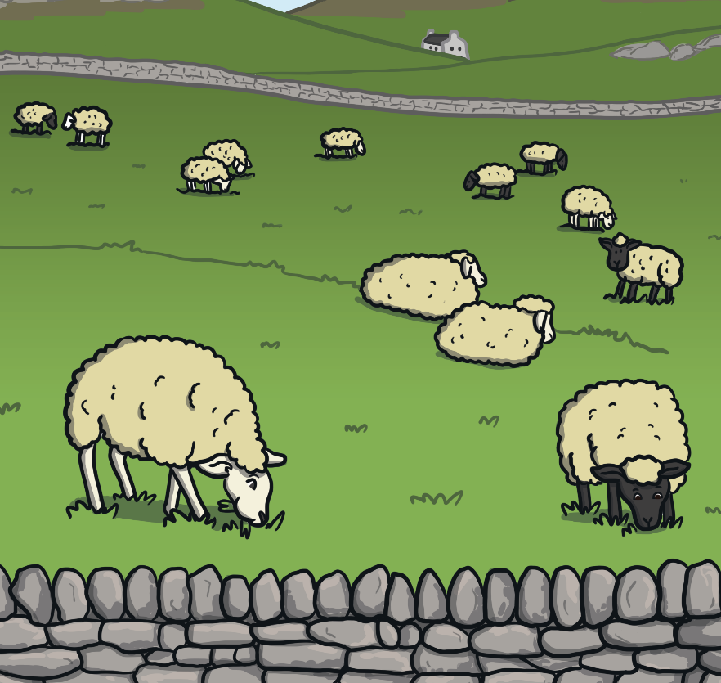
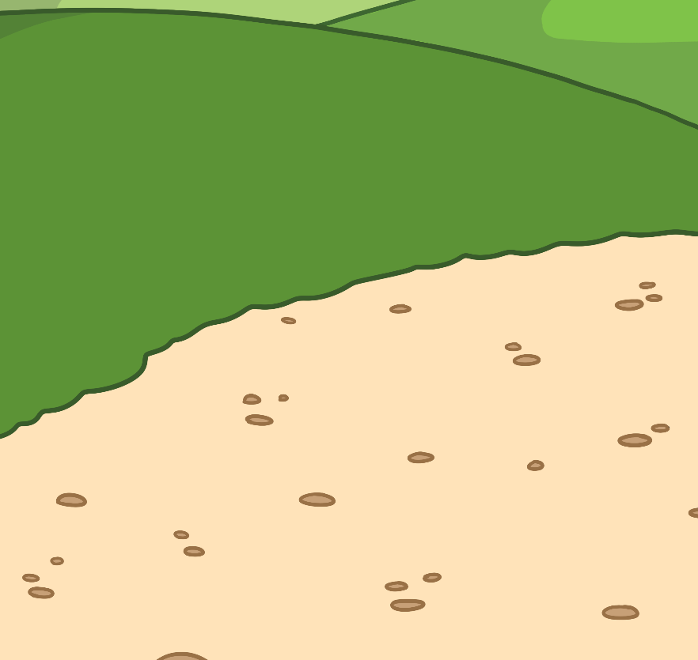
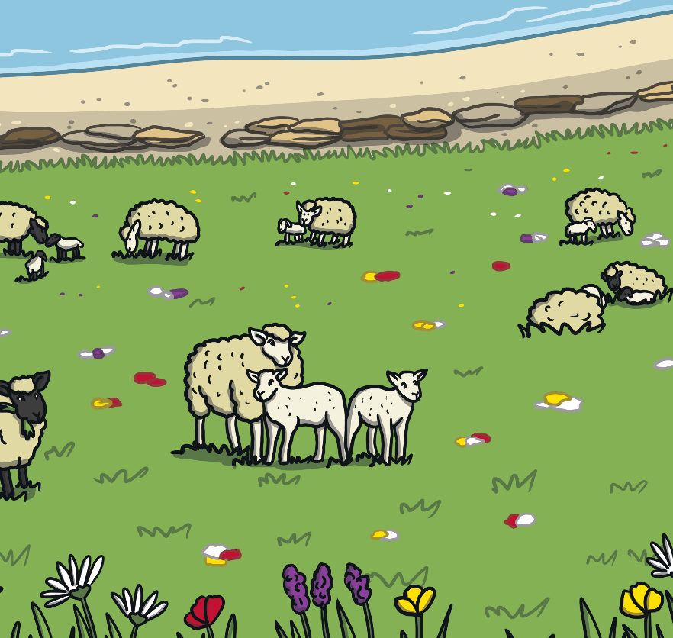
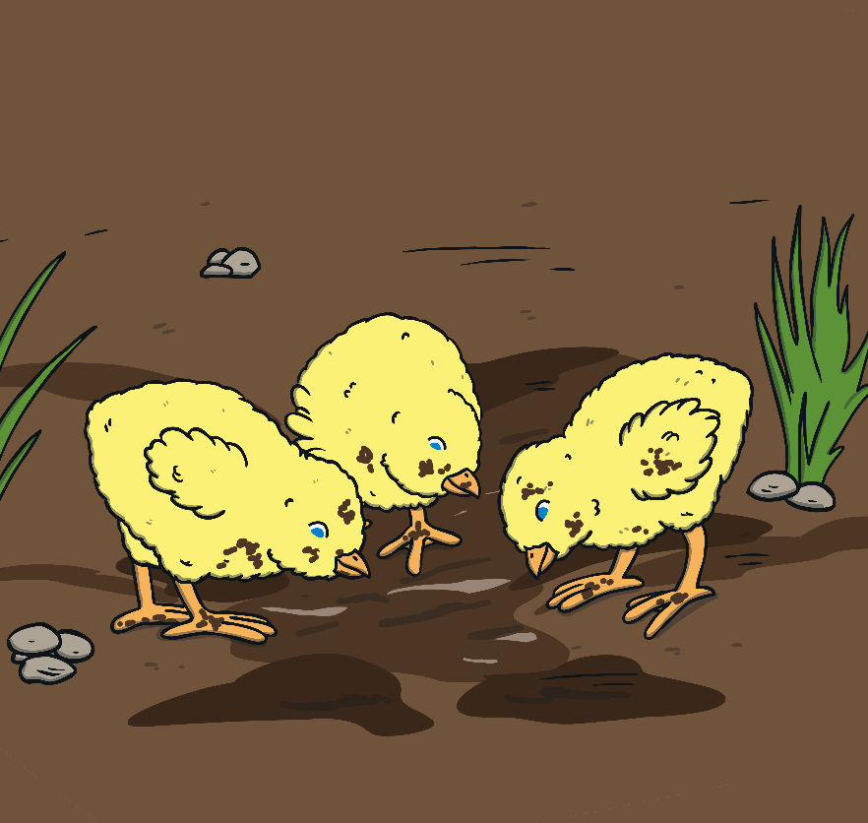
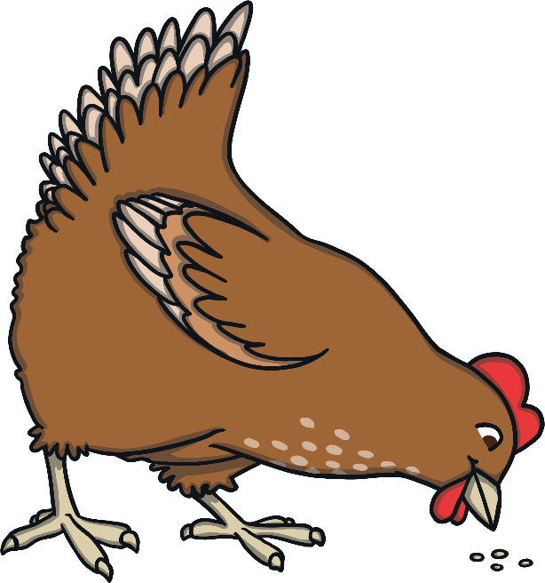
Compare the Seasons
Look at these pictures.
Compare what is happening in winter with what is happening in spring.
What is different?

Slide 9
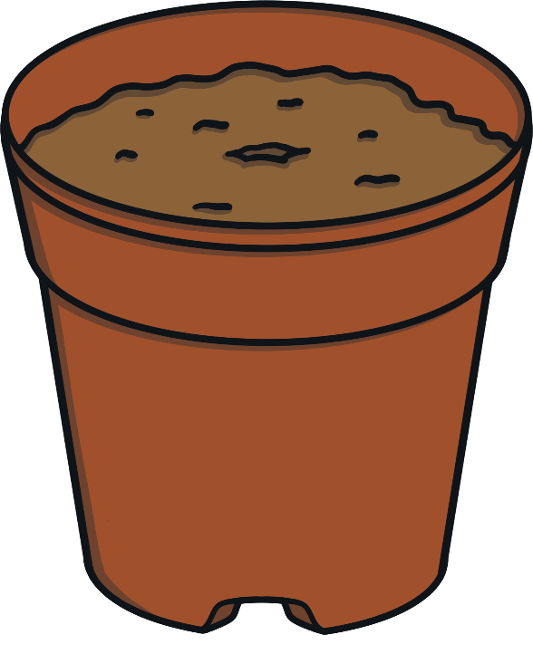
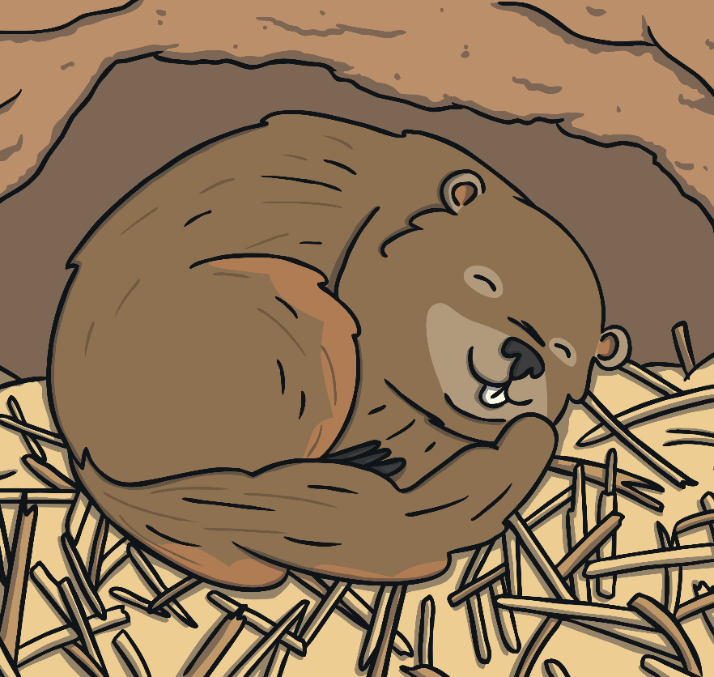


Compare the Seasons
Look at these pictures.
Compare what is happening in winter with what is happening in spring.
What is different?

Slide 10
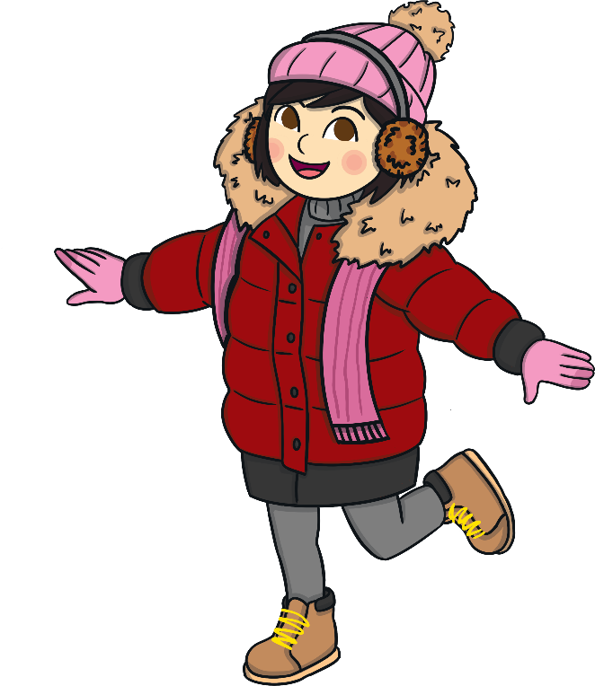
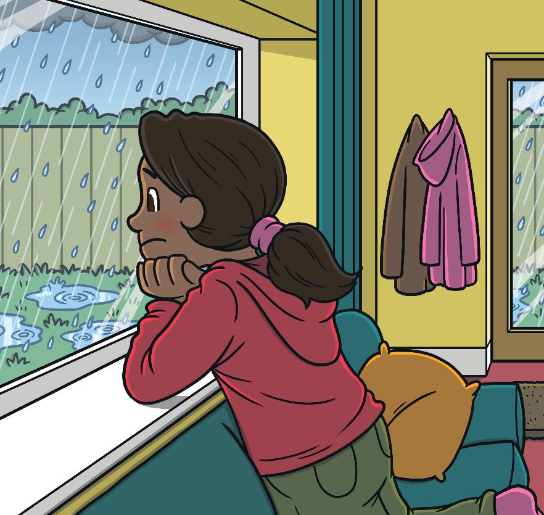
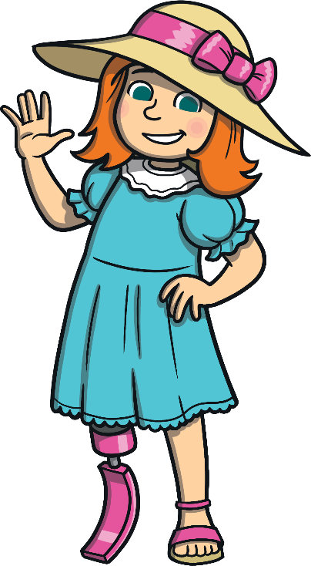
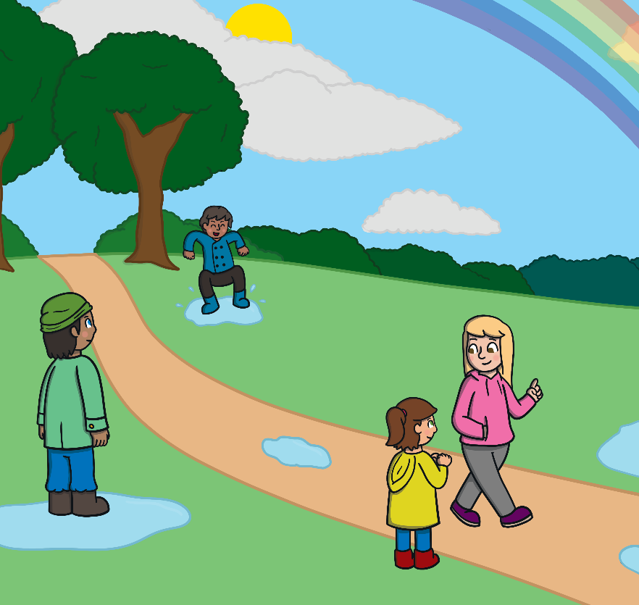
Compare the Seasons
Look at these pictures.
Compare what is happening in winter with what is happening in spring.
What is different?

Slide 11
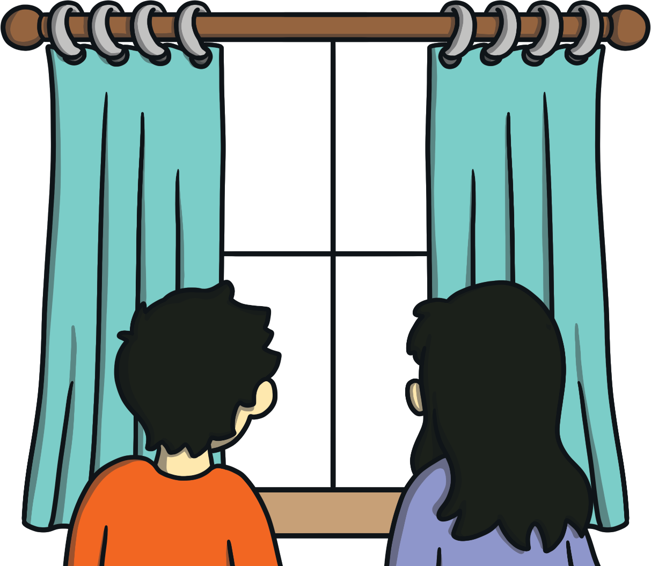

Daylight Hours
Imagine you looked out of your bedroom window at 5 p.m. in winter. What would you see?
What difference would there be if you looked out of the window at the same time in spring?

Slide 12


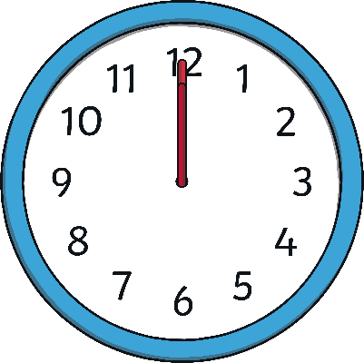
Daylight Hours
Many people who live in the United Kingdom say that the ‘days get shorter’ in winter and ‘days get longer’ in spring. What does this mean?
Spring
Winter
The days don’t actually get longer or shorter - there are always 24 hours in a day.
But, in spring there are more hours of daylight and in winter there are fewer hours of daylight.
AM
AM
PM
PM

