Slide 2
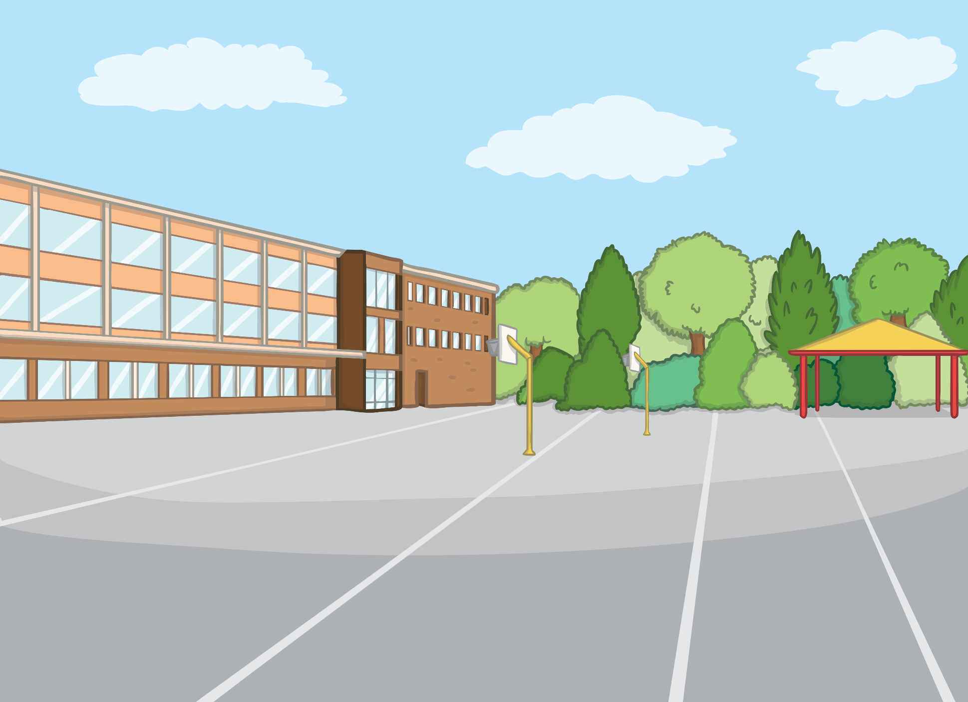

What Does It Mean to Be Healthy?
What you eat and the things you do have an effect on your body.
It is important to have a balanced diet, which means getting all the nutrients you need. Get enough exercise and get a good amount of sleep each night. All of these things will help you to have a healthy lifestyle.

Slide 3



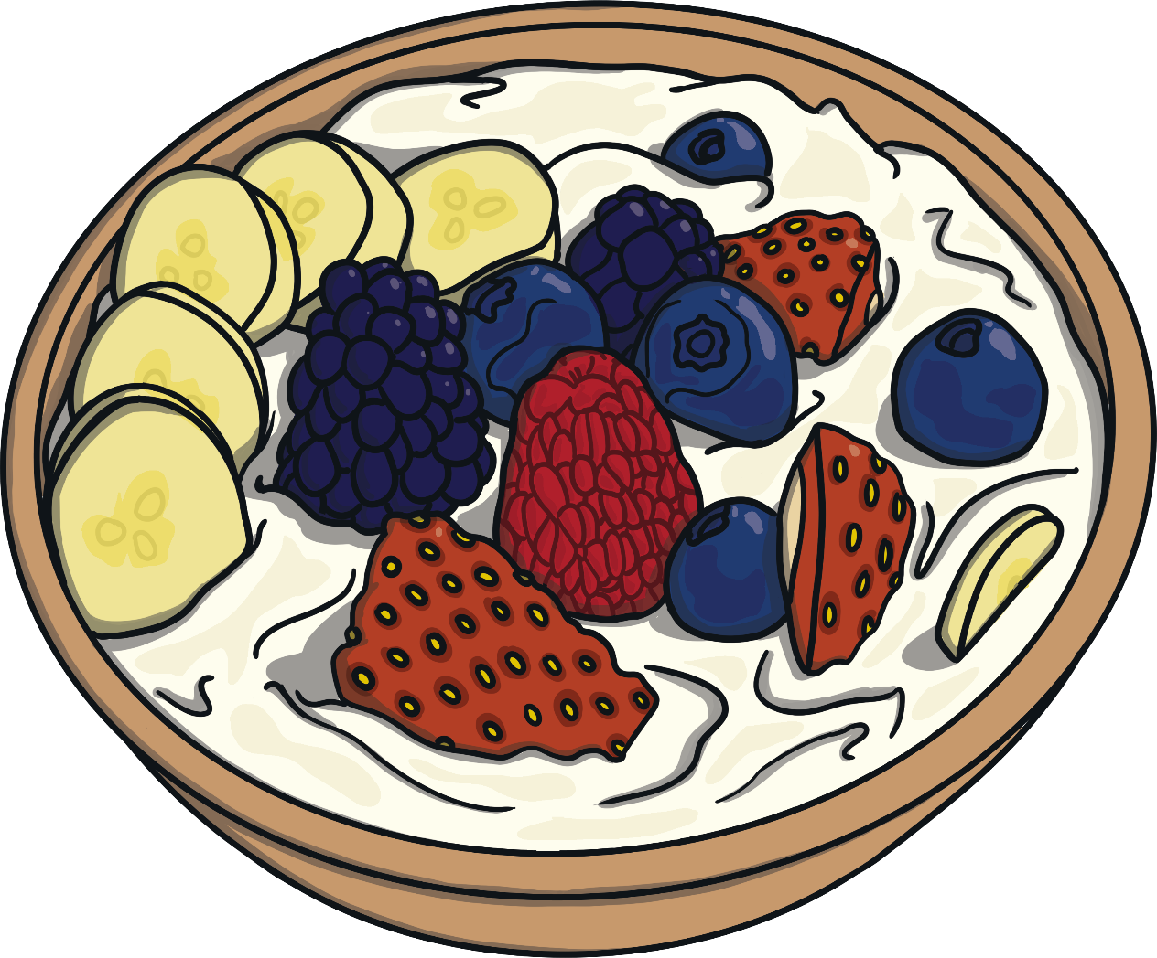
Healthy Eating
To keep your body healthy, you need to eat the right amount of vitamins and minerals each day. Make sure you eat plenty of fruit and vegetables and grains such as pasta, bread and rice. Try to limit the amount of salty, fatty and sugary food you eat. Everything is OK to have as long as you don’t have too much!

Slide 4
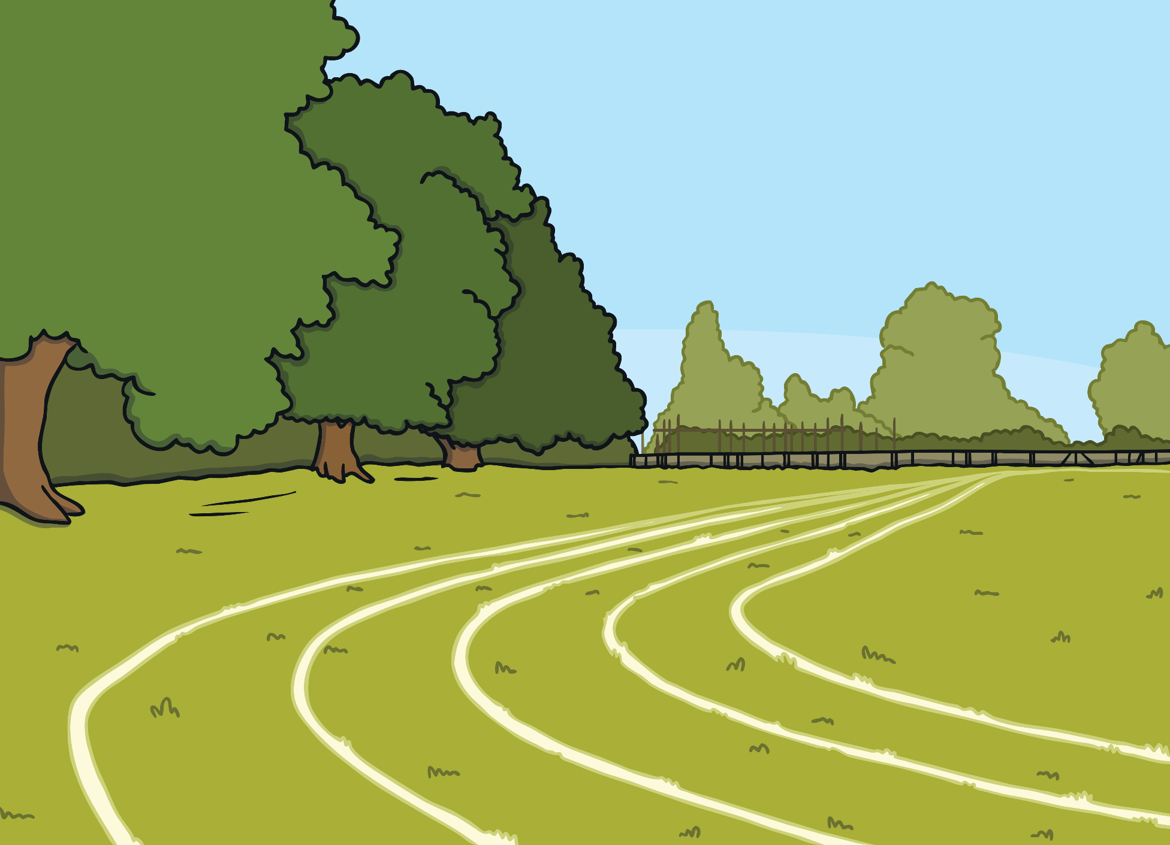
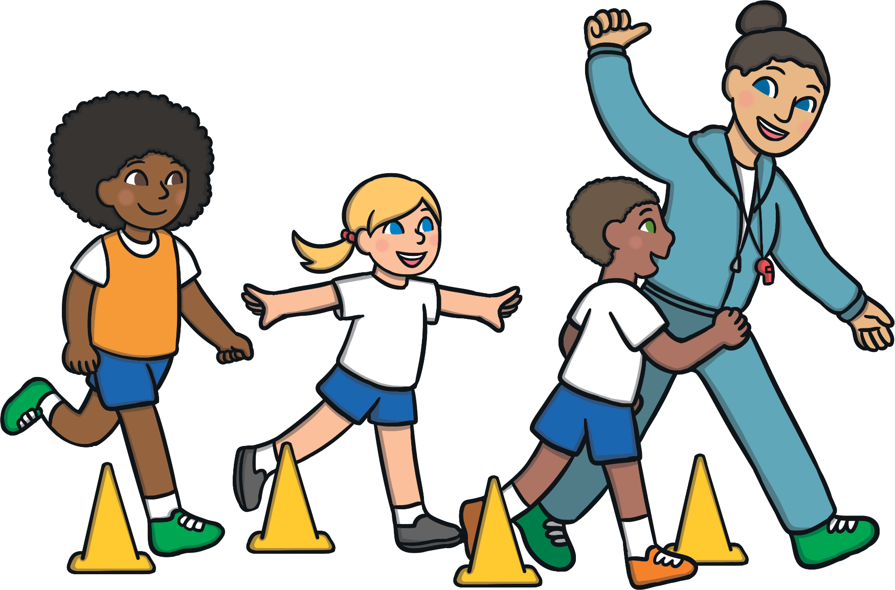
Keep Moving
It is important to exercise for between 30 and 60 minutes each day. This might be by walking to and from school or by just playing a game in the playground at lunchtime!

Slide 5

Sleep
Make sure to get enough sleep. It is recommended that children between five and seven years old should get 11 hours of sleep per night. Try to stop using screens at least an hour before bedtime to allow your brain to fully switch off!

Slide 6






Screen Time
It is important not to spend too much time on electronic devices. This includes watching television, playing video games and time on tablets. You should try not to spend more than two hours a day on electronic devices and definitely keep all devices out of your bedroom to help you settle down for sleep.

Slide 7

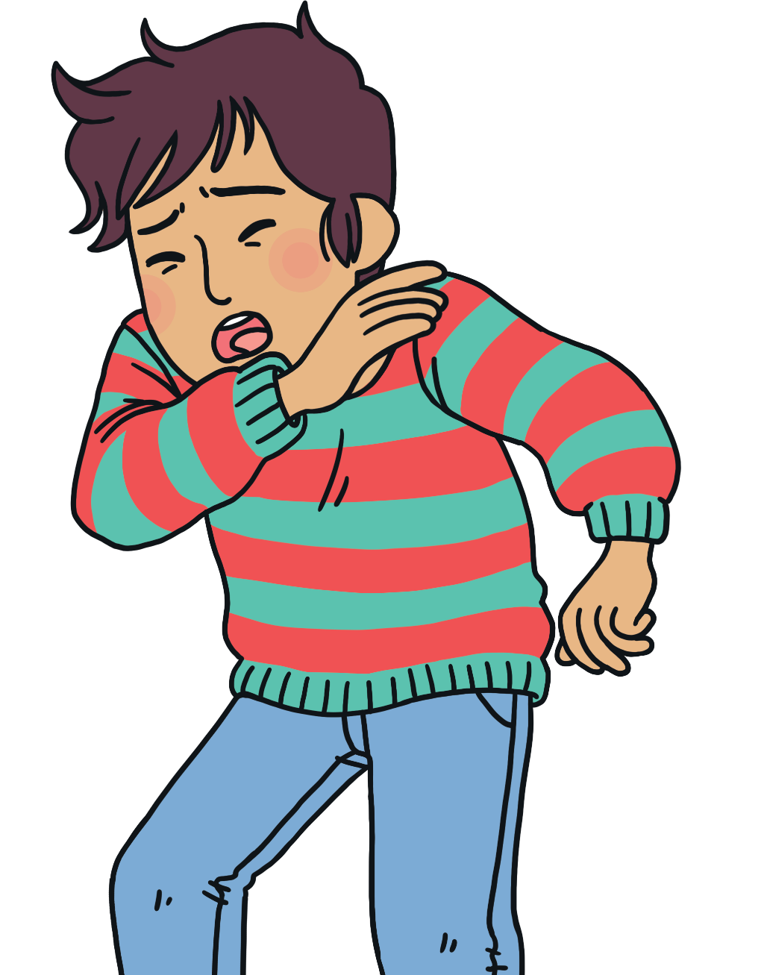
Coughs and Colds
It is important to try and stop the spread of coughs and colds, especially in the winter. To protect yourself and others, make sure you cough into the bend of your elbow. Try to sneeze into a tissue. If you can’t do this, sneeze into your sleeve in the bend in your elbow. Always wash your hands after sneezing and make sure to put the tissue into the bin!

Slide 8
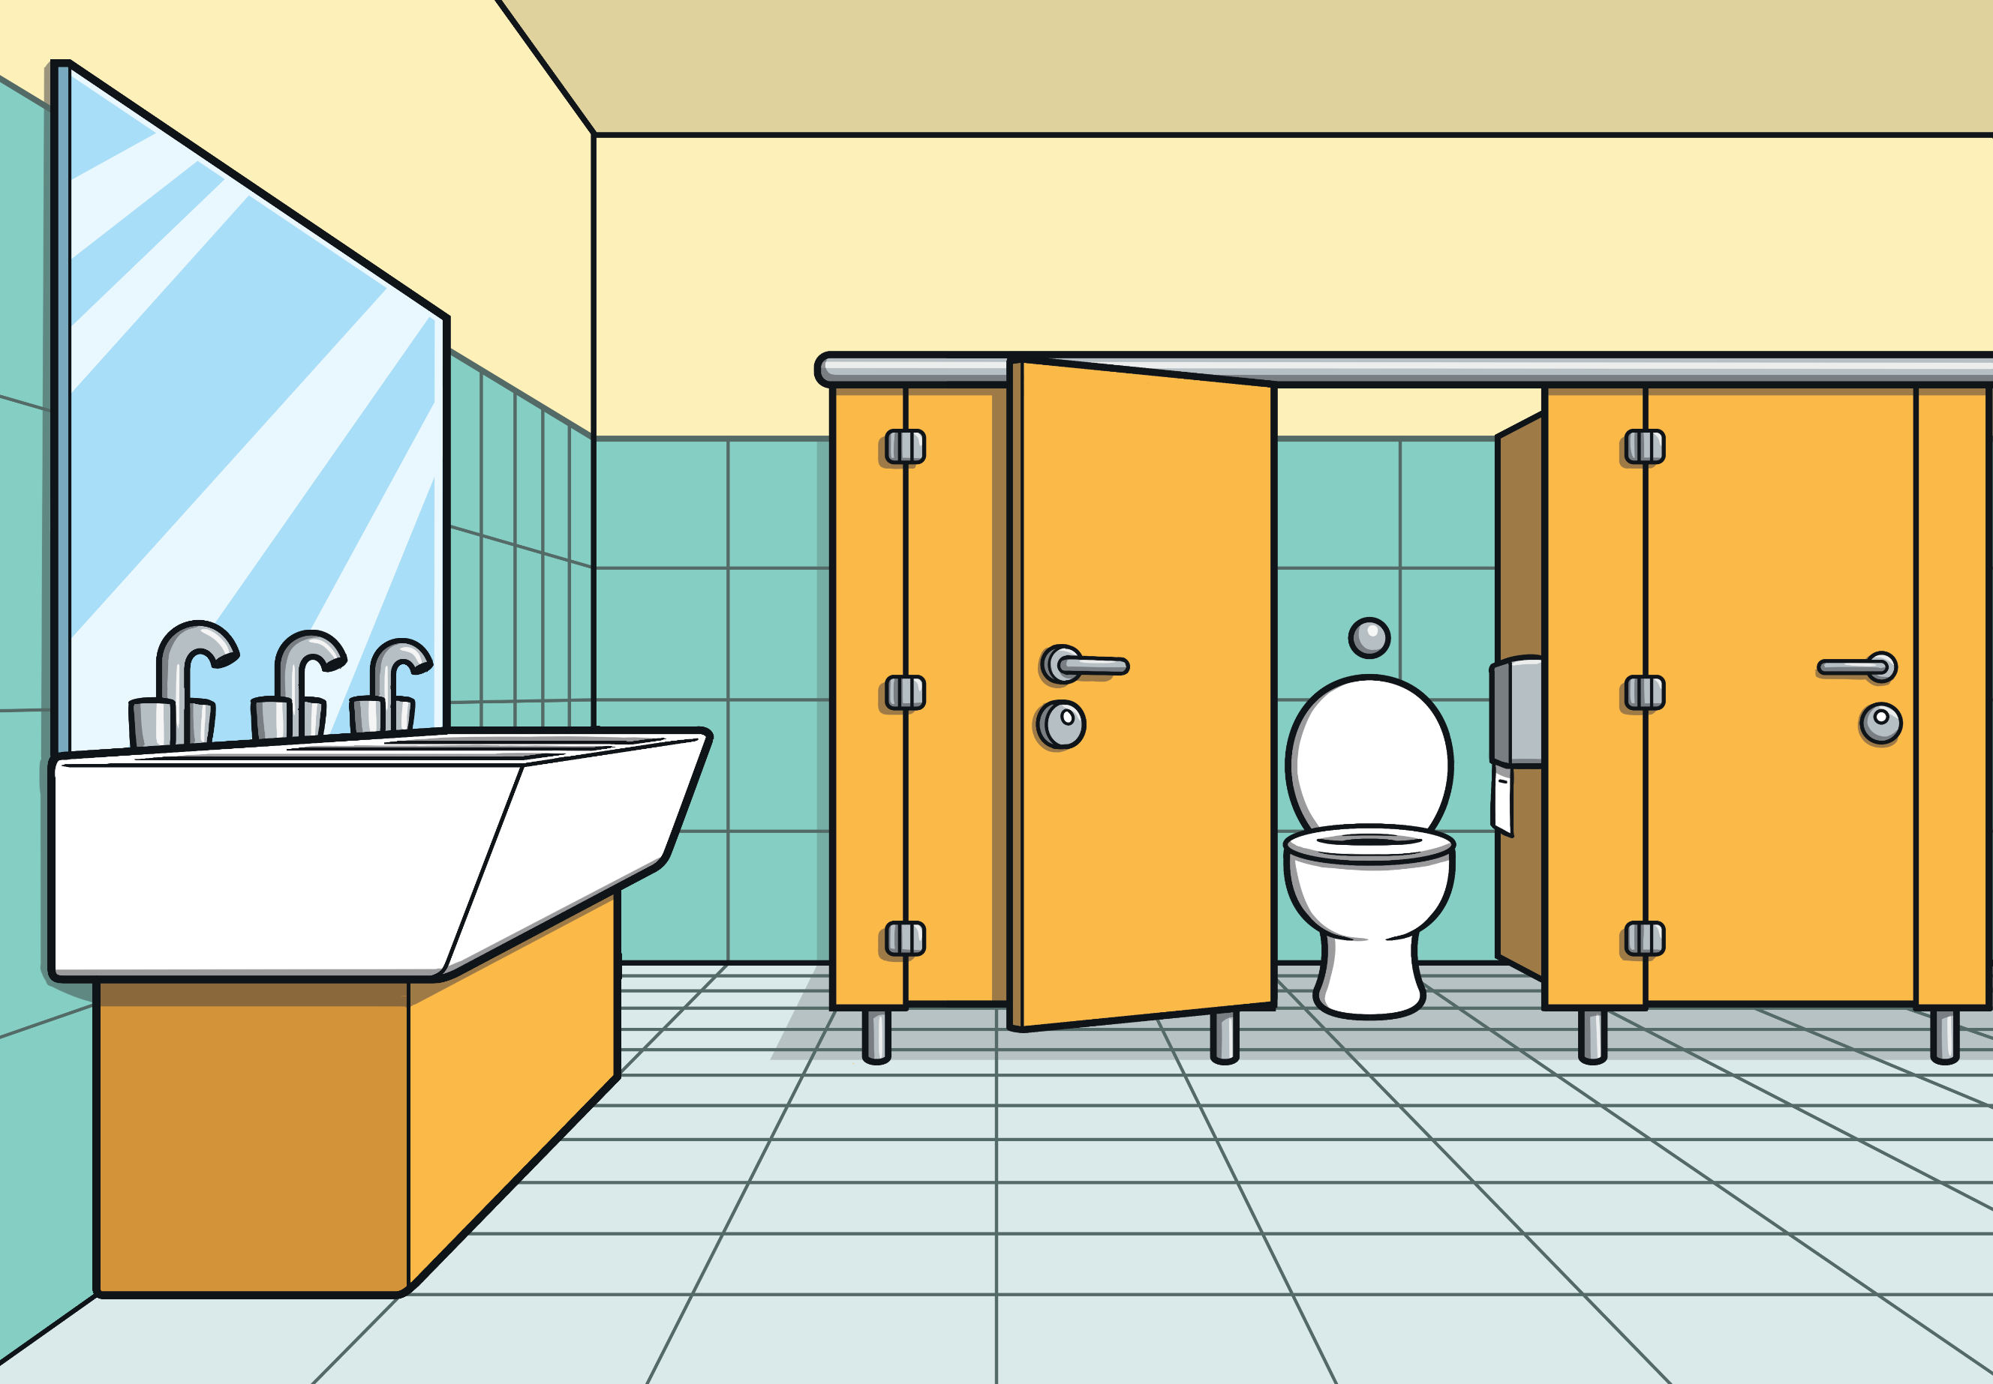
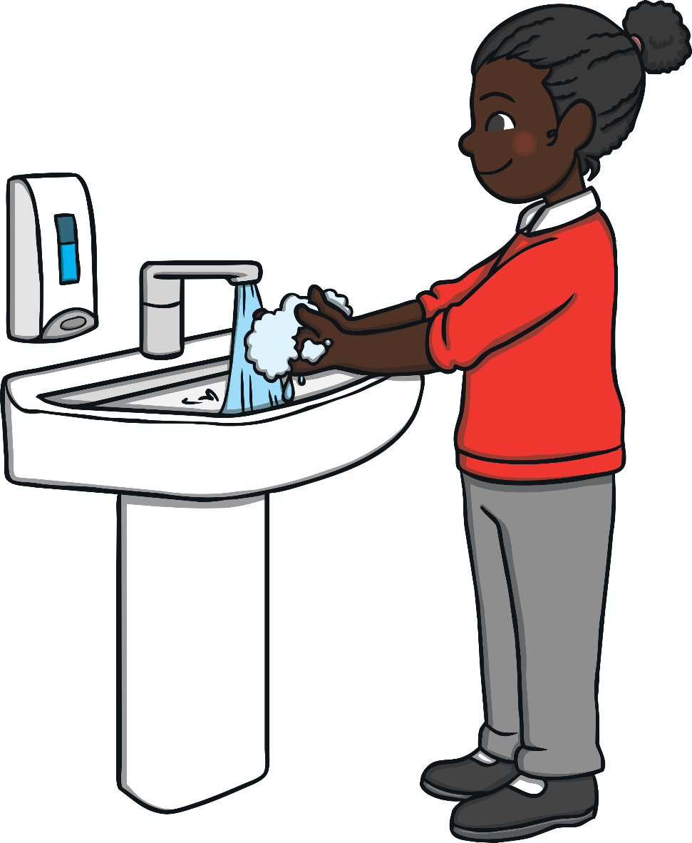
Keeping Well
To help protect yourself from getting ill, make sure you wash your hands after going to the toilet, before you eat and after you touch animals. Your hands can carry a lot of germs; most are nothing to worry about but it is best to be on the safe side!

Slide 9
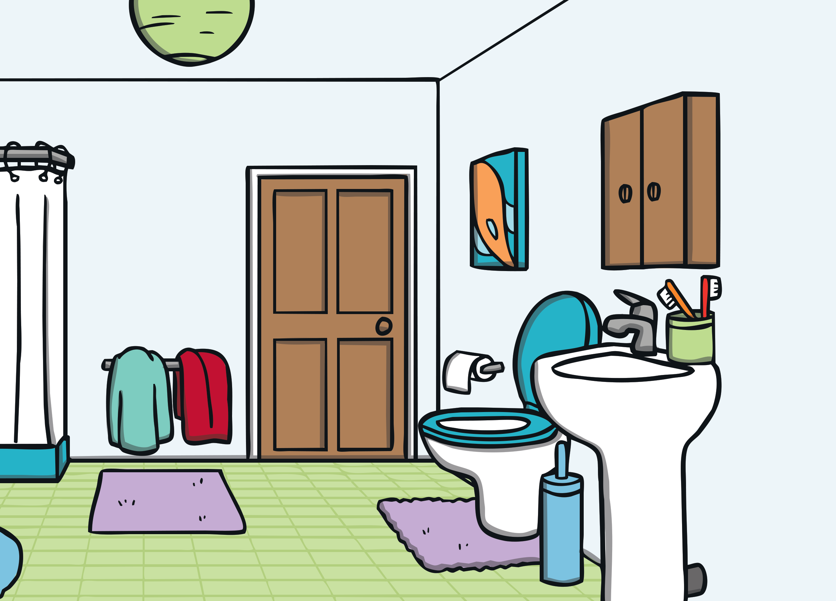
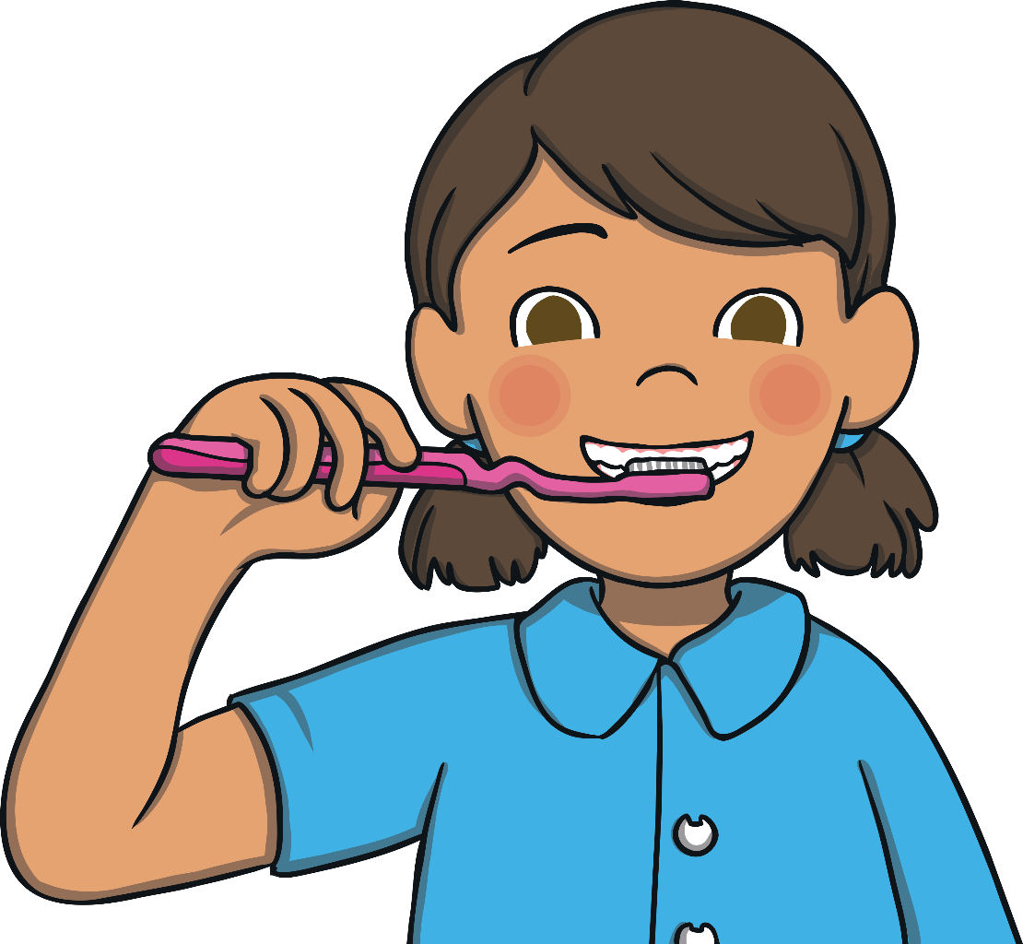
Healthy Teeth
Just like your body needs exercise to stay healthy, you also need to keep your teeth healthy. To keep your teeth nice and strong, make sure to reduce the amount of sugary foods you eat and brush your teeth at least twice a day for a minimum of two minutes. Eating plenty of food high in calcium – such as cheese, milk and yoghurt – can also help your teeth
and bones to be strong!

