Slide 1


Guided Reading
The Little Red Hen
Year One
Guided Reading | Year 1 | The Little Red Hen

Slide 3
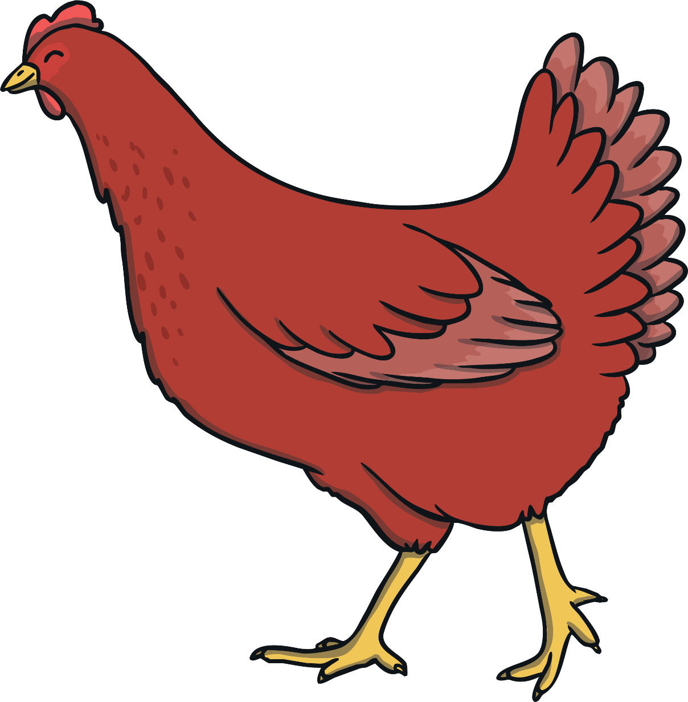
Once upon a time, there was a Little Red Hen. The Little Red Hen lived on a farm and was friends with…

Slide 4
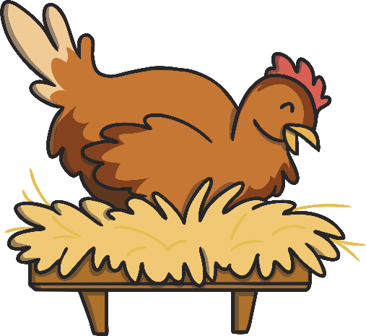
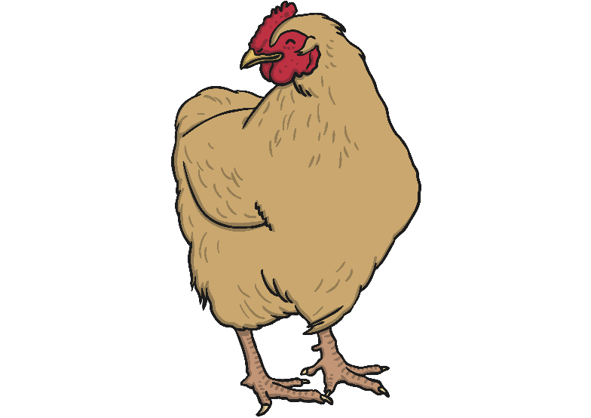
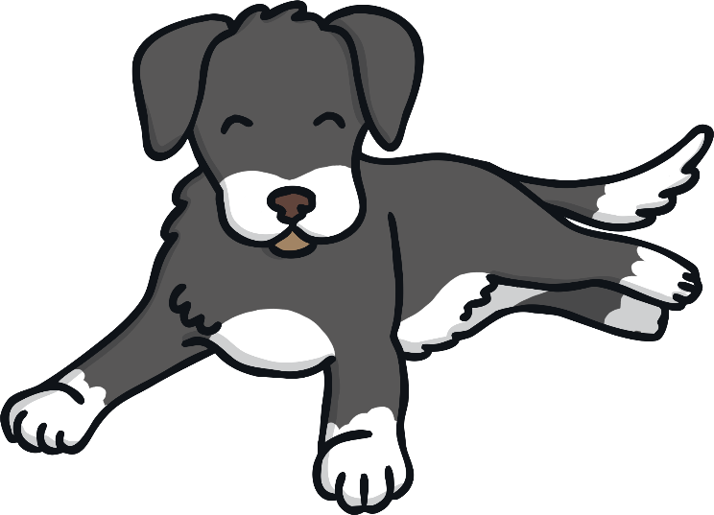
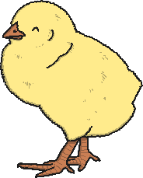
…a lazy dog…

Slide 5
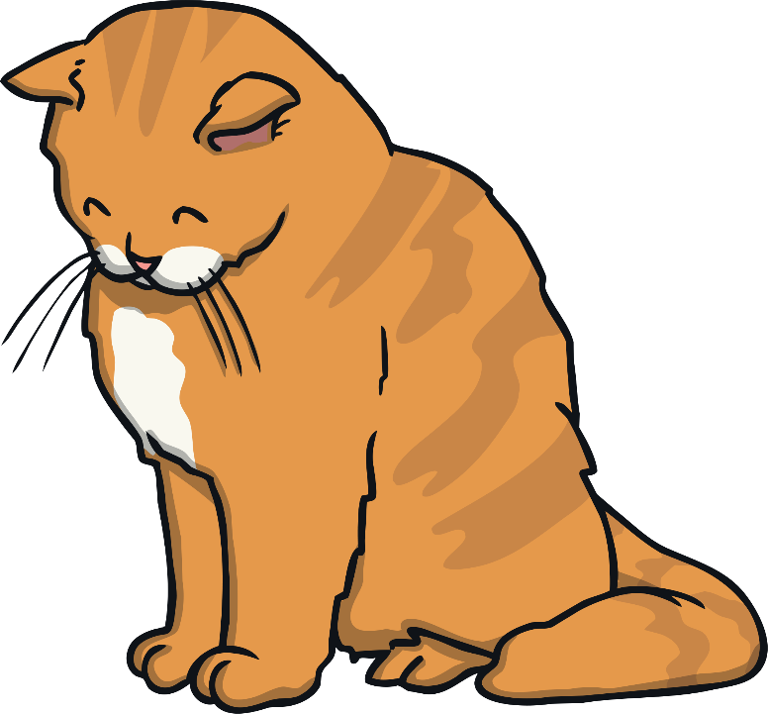
…a sleepy cat…
z
z
z
z

Slide 6
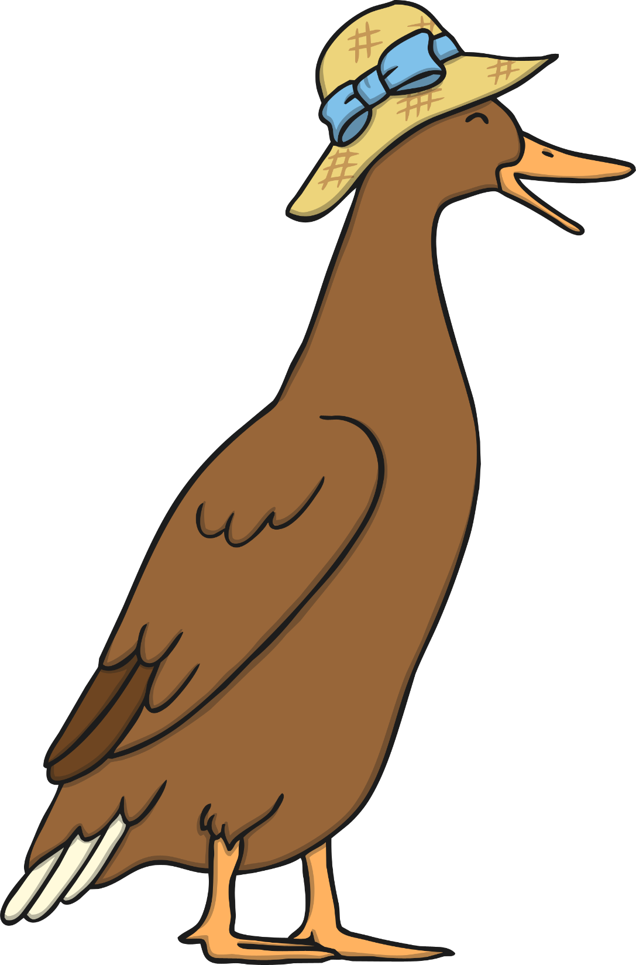
…and a noisy duck.

Slide 7

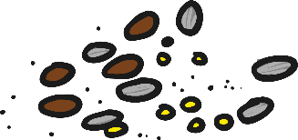
One day, the Little Red Hen found some grains of wheat on the ground.
“Who will help me plant these grains of wheat?” the Little Red Hen asked.

Slide 8

“Not I,” barked the lazy dog.

Slide 9
“Not I,” purred the sleepy cat.

Slide 10

“Not I,” quacked the noisy duck.

Slide 11
“Then I will do it myself,” said the Little Red Hen.
So she planted the grains all by herself.

Slide 12
When the wheat had grown, the Little Red Hen asked her friends, “Who will help me cut the wheat?”

Slide 13
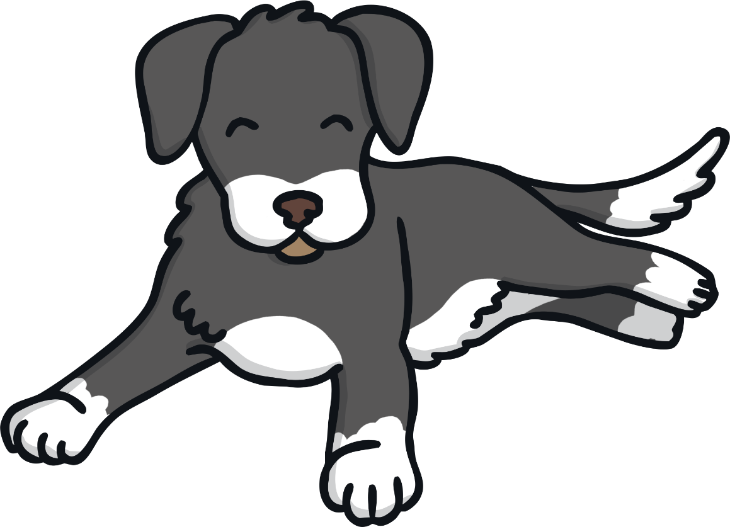

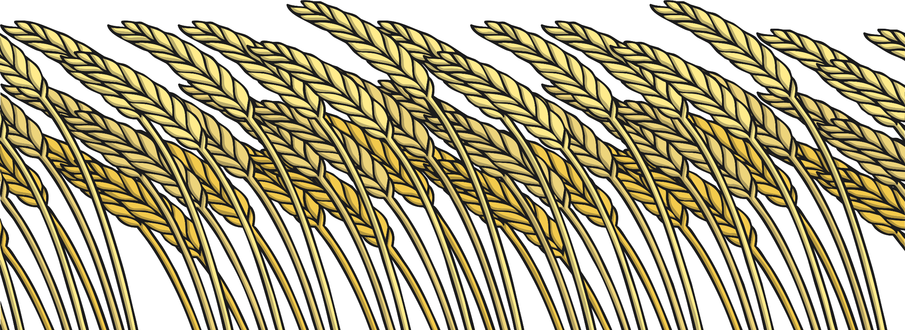
“Not I,” barked the lazy dog.

Slide 14

“Not I,” purred the sleepy cat.

Slide 15
“Not I,” quacked the noisy duck.

Slide 16
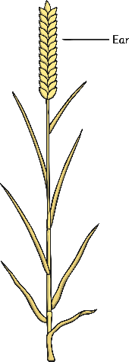

“Then I will do it myself,” said the Little Red Hen.
So she cut the wheat all by herself.

Slide 17
When all the wheat was cut, the Little Red Hen asked, “Who will help me take the wheat to the mill, to be made into flour?”

Slide 18
“Not I,” barked the lazy dog.

Slide 19
“Not I,” purred the sleepy cat.

Slide 20
“Not I,” quacked the noisy duck.

Slide 21

“Then I will do it myself,” said the Little Red Hen.
So she took the wheat to the mill, ground the wheat into flour and carried it back to the farm all by herself.

Slide 22
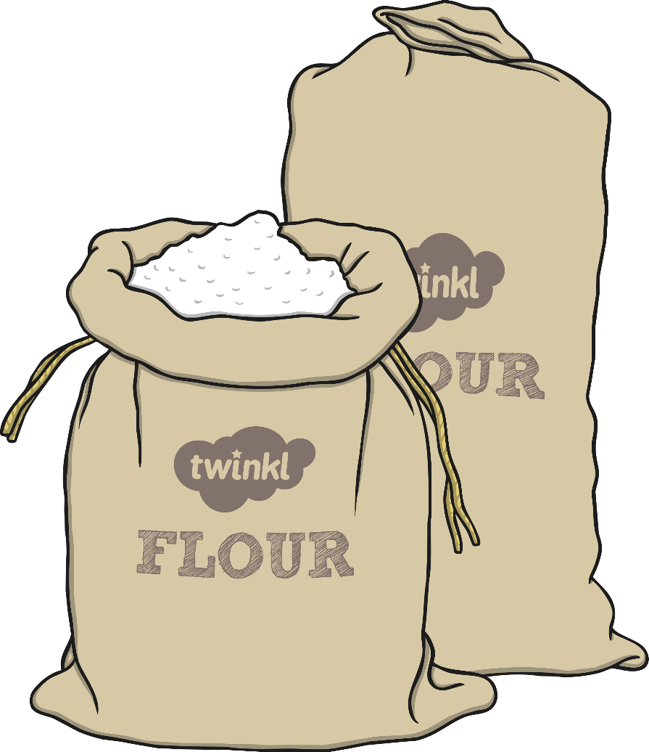

By now, the Little Red Hen was tired. “Who will help me bake the bread?” she asked.

Slide 23

“Not I,” barked the lazy dog.

Slide 24
“Not I,” purred the sleepy cat.

Slide 25
“Not I,” quacked the noisy duck.

Slide 26
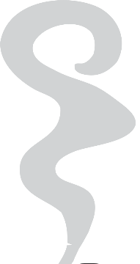
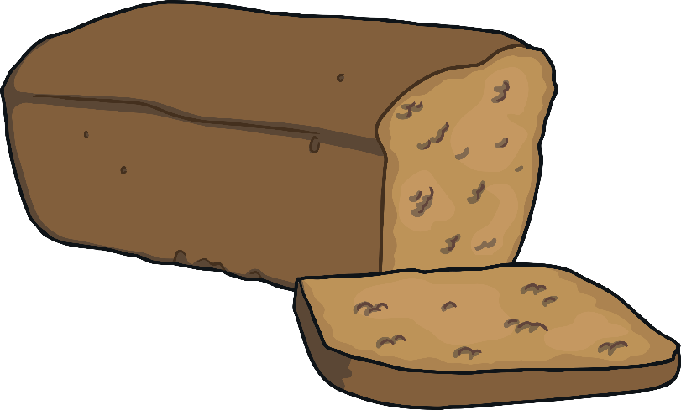
“Then I will do it myself,” said the Little Red Hen.
So she baked the bread all by herself.

Slide 27
When the bread was finished, the Little Red Hen asked, “Who will help me eat the bread?”

Slide 28
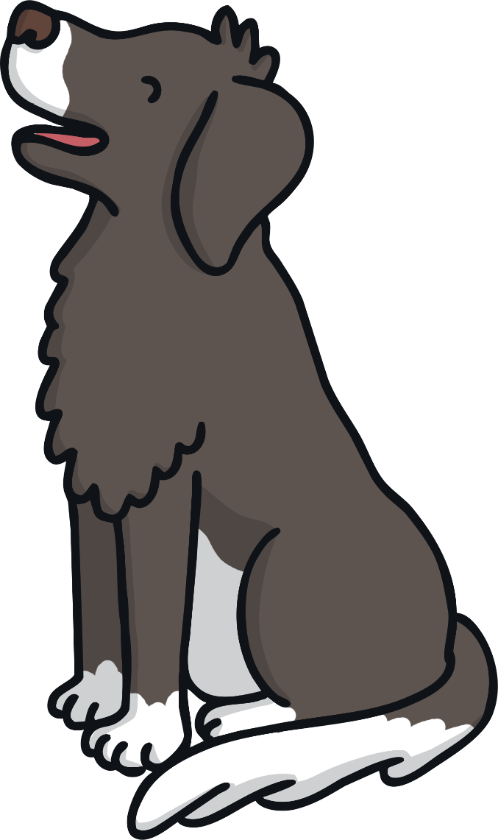
“I will!” barked the lazy dog.

Slide 29

“I will!” purred the sleepy cat.

Slide 30
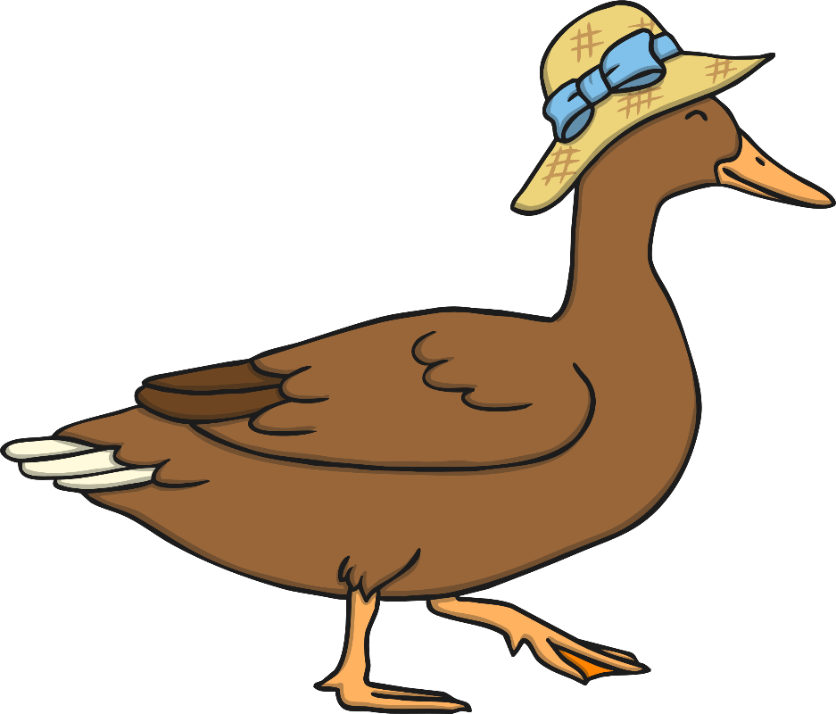
“I will!” quacked the noisy duck.

Slide 31
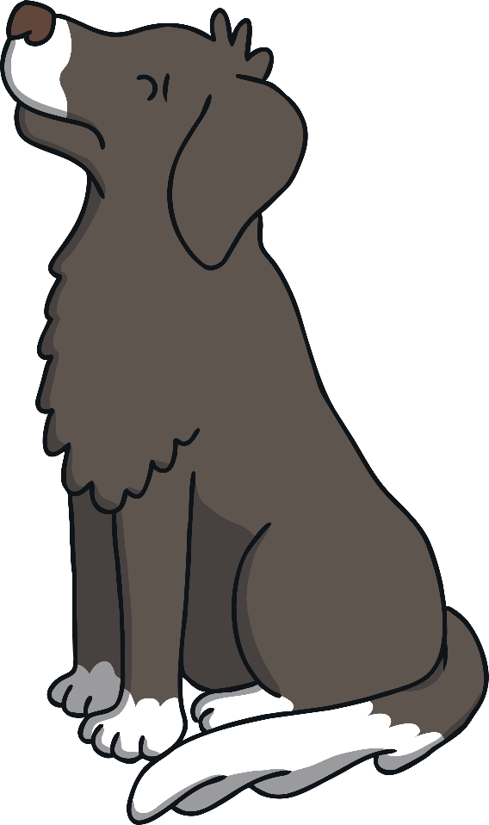
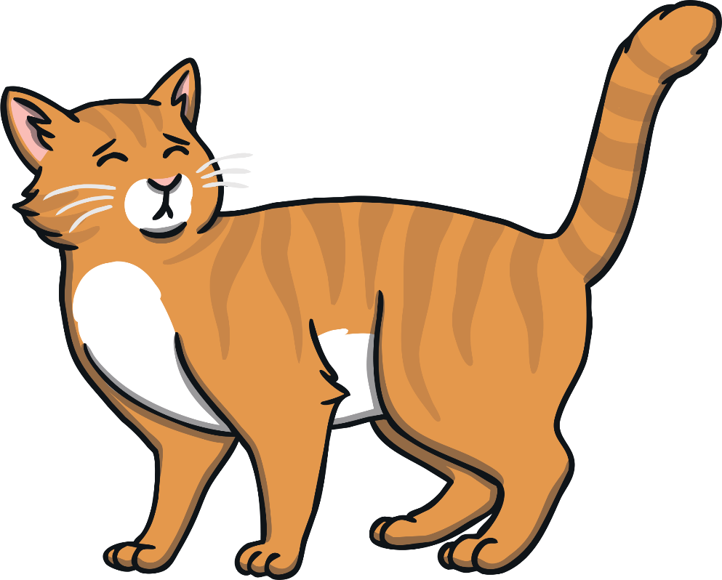
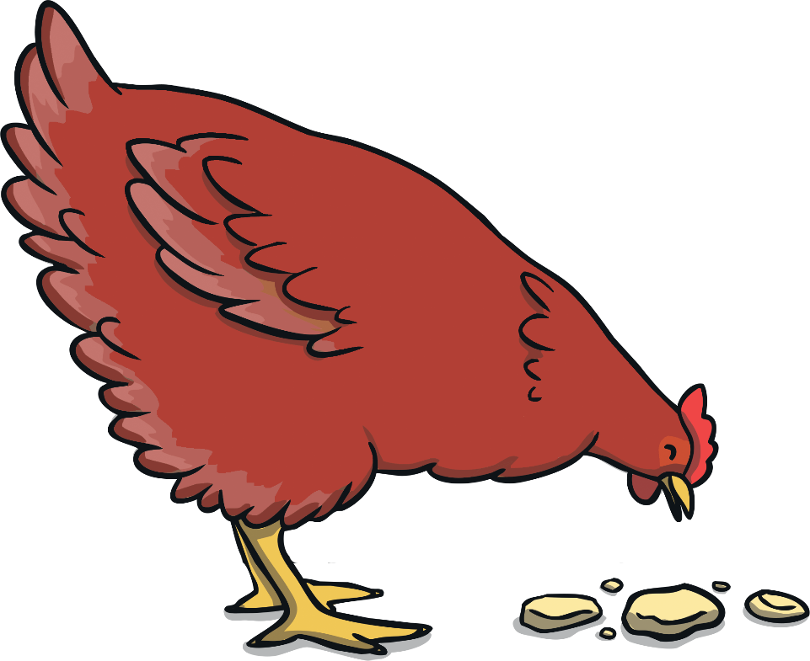
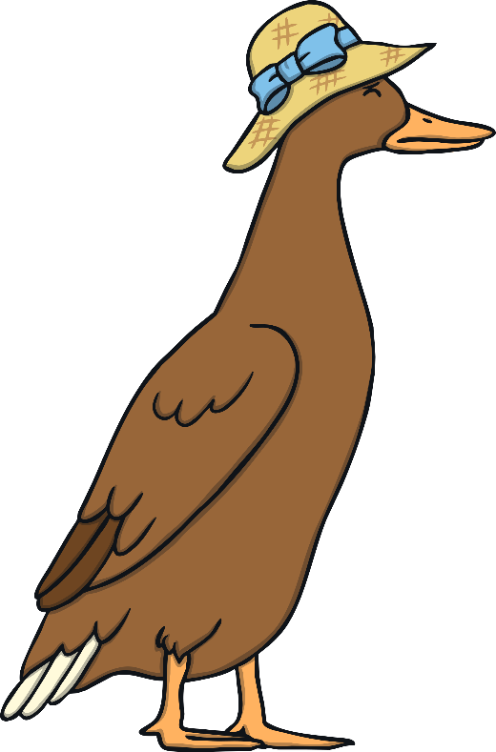
“No. I will eat it myself!” said the Little Red Hen.
So she ate the bread all by herself.

